Slide 1
MANAGING A USAID AWARD
TO LOCAL PARTNERS
USAID/Burundi
Formation sur la Localisation​
Presenter:
Catherine Brokenshire-Scott | ASAP Project Director
Date : 26-28 juin 2024
Notes:
Remarque : cette session sera enregistrée

Slide 2
TOPICS
S
USAID Local Capacity Strengthening Policy
Roles and Responsibilities
Key Principles of Managing Awards
Local Partners’ organizational growth and capacity strengthening during a site visit

Slide 3
USAID Local Capacity Strengthening Policy

Slide 4
What is Local Capacity Strengthening?
USAID Capacity Definition
Local Capacity Strengthening
Capacity encompasses the knowledge, skills, and motivations, as well as the relationships that enable an actor to:
Take action to design and implement solutions to local development challenges,
To learn and adapt from that action
Innovate and transform over time
A strategic and intentional investment in the process of partnering with local actors to jointly improve the performance of a local system to produce locally valued and sustainable development outcomes

Slide 5
USAID & PEPFAR Timeline
PEPFAR goal to direct 70% of its funds to local partners
Launch of PEPFAR Strategic Pillars
Launch New Partnership Initiative
Administrator’s Georgetown Speech
2017
2018
2019
2020
2021
2022
Issue Agency’s first A&A Strategy
Localization Effort formally launched…

Slide 6
FY 2022 LOCALIZATION PROGRESS & FY 2023 WORKSHOP REPORT
Access the reports: www.usaid.gov/localization
Notes:
Interesting about the “Partners in Localization: Designing for Change” report is that many of the findings overlap with the findings from our local organizations meeting feedback sessions, which we’ll review a bit later

Slide 7
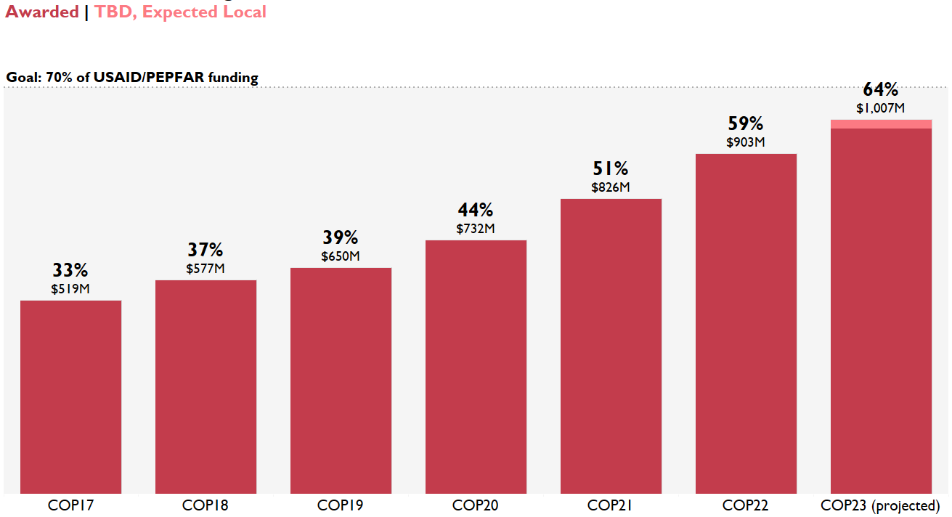
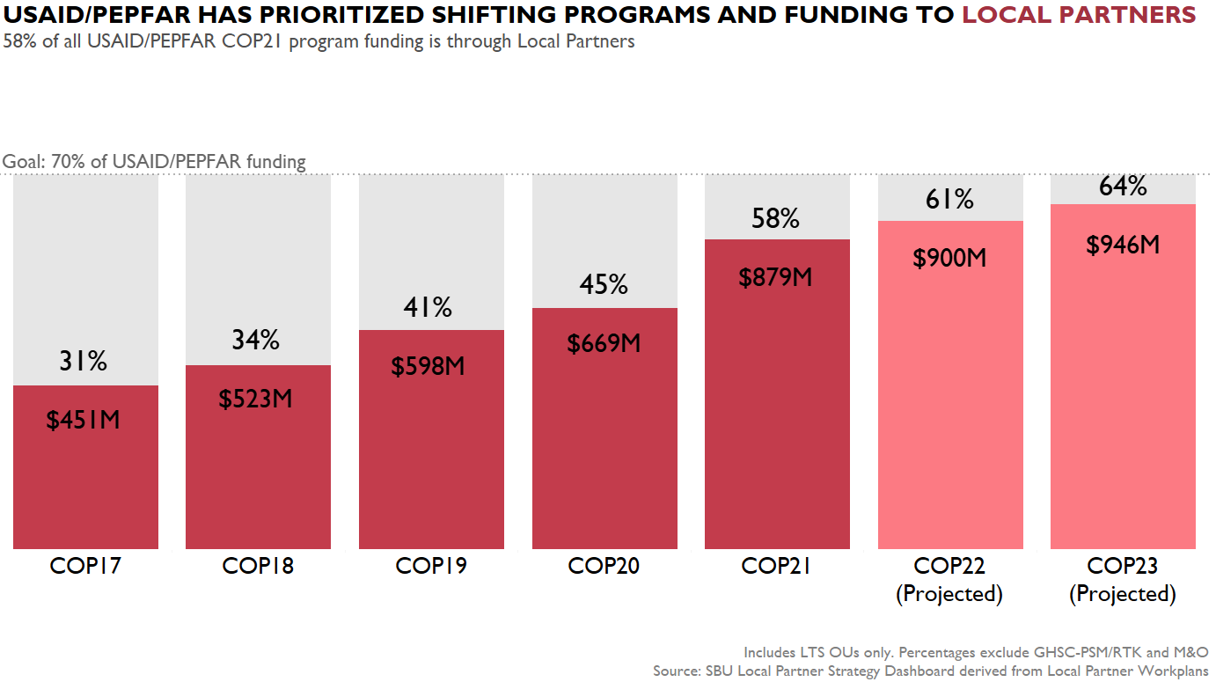
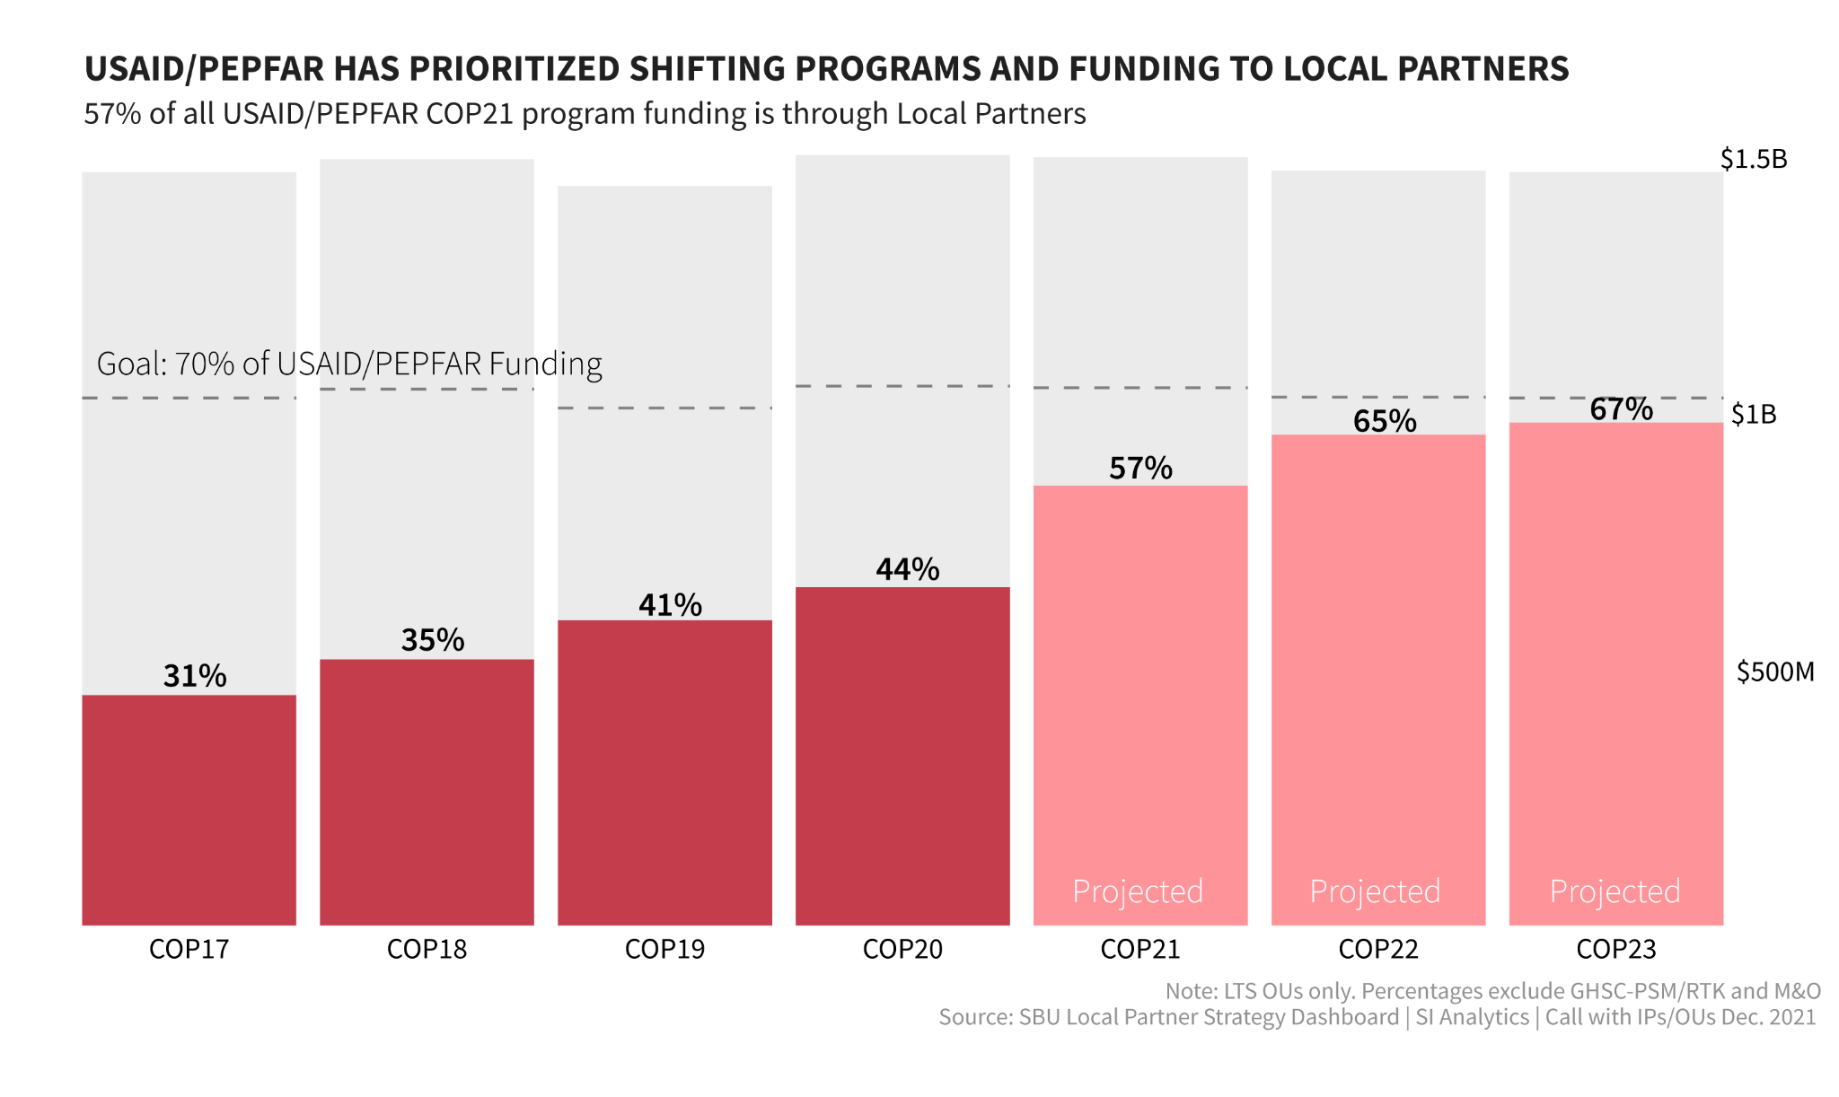
Looking globally | Majority of USAID’s HIV funding is now going directly to local organizations and partner governments since local partner announcement
2018 | PEPFAR announced its goal to direct 70% of its funds to local partners
2023 | Estimated 94% increase in direct funding to local entities
COP23 USAID
64%
of USAID/PEPFAR program funding is through Local Partners
Percentages exclude GHSC-PSM/RTK and M&O
Source: Standard COP Matrix (as of 3/4/2024) and internal records on TBDs.

Slide 8
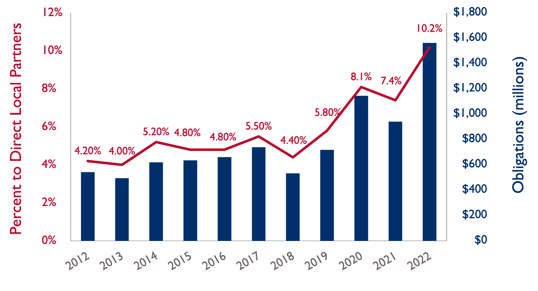
In FY 2022, USAID recorded the highest level and percent of Direct Local Funding in at least a decade

Slide 9
THREE TYPES OF FUNDING FOR LOCALIZATION
Government to Government (G2G)
$199 million
Non-Local Acquisitions & Assistance (A&A) Funding
$13.7 billion
Direct Local Funding $1.6 billion
Direct Regional Funding
$57 million

Slide 10
By sector, Health is leading
Democracy, Human
Rights & Governance
Humanitarian Assistance
Peace & Security
Program Development
& Oversight
Economic Growth
Health
Education &
Social Services

Slide 11
USAID Lines of Efforts
1. Adapting Policies and Program Practices
Tied to political, social, cultural, economic, and environmental conditions
2. Shifting Power to Local Actors
Integrating a diverse group of local voices and leadership of and barriers to change
Principle “ Nothing About Us Without Us”
3. Channeling Significant Portion of Assistance to Local Partners
Use for development and humanitarian needs
Align awards wand activities with local partners’ goals, capacities, and experience with USAID
4. Serve as a Public Advocate and Thought Leader
Link localization efforts across the interagency – including DFC, MCC, PEPFAR
USAID seeks to catalyze changes across the broader development community
Notes:
USAID will pay particular attention to elevating the voices of underrepresented populations: women and girls, LGBTQI+ people, persons with disabilities, Indigenous Peoples, marginalized racial, ethnic and religious populations, internally displaced persons, youth and elderly, and other socially marginalized individuals and groups.

Slide 12
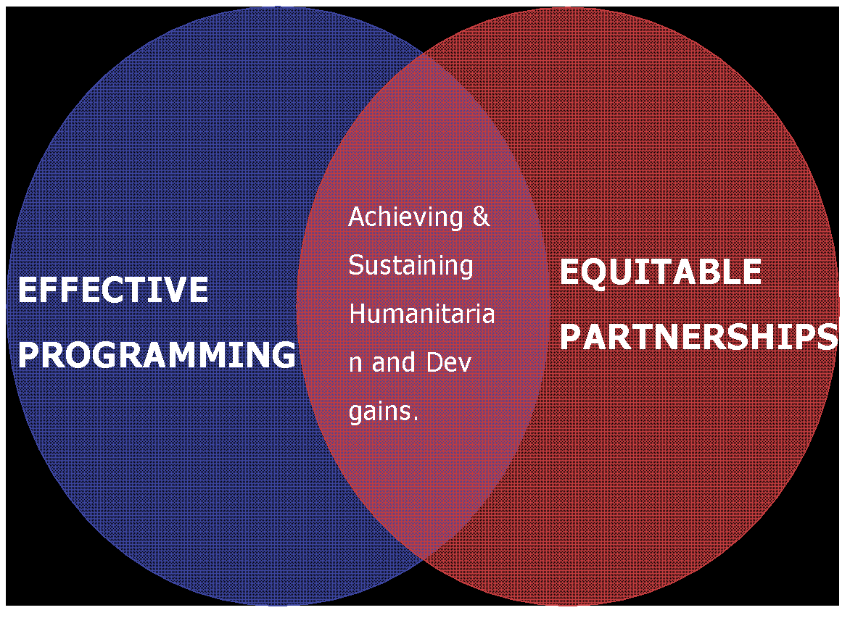
Seven Reinforcing Principles for Effective Local Capacity Strengthening
❶
Start with the local system
Align capacity strengthening
with local priorities.
Strengthen diverse capacities
through diverse approaches
❹
❷
❺
Appreciate and build on existing capacities
❸
Plan for and measure performance improvement in collaboration with local partners
Be mindful of and mitigate the unintended consequences of our support for local capacity strengthening.
❻
❼
Practice mutuality with local partners.

Slide 13
GROWING THE PIPELINE OF LOCAL ORGANIZATIONS

Slide 14
Recommended Activities
Open Online Survey
Industry Day in Capital
Roadshows for regions outside of the Capital
Landscape Analysis with select risk and compliance assessments
Incorporate Capacity Strengthening into Prime Awards with deliverables and deadlines
Provide Capacity Strengthening to Sub Partners
Create networks for Local Partners through Communities of Practice

Slide 15
ROLES AND RESPONSIBILITIES

Slide 16
How is USAID involved in each Award Type?
CONTRACT
Substantial Involvement
Always Involved
(Very Hands On)
COOPERATIVE AGREEMENT
Substantial Involvement
More Involvement
GRANT
No Substantial Involvement
Limited Involvement
Assistance
Acquisition

Slide 17
AGREEMENT OR CONTRACT OFFICER AUTHORITY:
Has legal responsibility for the award/Contract
Only one authorized to bind USAID legally
Can take action on behalf of USAID Change, terminate, or close out an award
Obligate US government funds (including incremental funds). RESPONSIBILITIES:
Ensures compliance with law, executive orders, regulations, and all other applicable procedures.
Initiates actions following audits, investigations or AOR/COR’s findings (disallowances), or other remedial actions.
Maintains the official agency file for the award/Contract.
ROLES AND RESPONSIBILITIES
AO/CO REPRESENTATIVE
AUTHORITY:
Only as delegated by AO
Exercises USAID’s substantial involvement responsibilities.
RESPONSIBILITIES
Maintains contact with the awardee/contractor through site visits, technical communication, and liaison.
Reviews and analyzes performance and financial reports for adequacy, responsiveness, and timeliness.
Exercises USAID’s substantial involvement responsibilities.

Slide 18
Exercise 1: Whose Responsibility is it?
Responsabilité | OMS?
Make an Award | AO
End an Award | AOR
Modify the scope of the Agreement | AO
Visit Awardee field Activities | AOR et/ou AO
Daily Communication with Awardee | AO
Make modifications to the budget | AO
Make any commitments | AOR
Participate in meetings with Prime | AOR et/ou AO
Approval of Key Personnel | AOR
International Travels | Vérifier les termes de l'accord
Make an Extension commitment | USAID Country Manager
Modify a budget line | USAID Activity Manager
Modify a Health Activity in Approved workplan | Mission Senior Nutrition Specialist
Modify a Health Activity in Approved workplan | Mission Senior Health Specialist
Give a Partner a Cure Notice | AOR
True or False?
Yes
No
Yes
Yes
No
Yes
No
Yes
Yes
Yes
No
No
No
No
No
Notes:
Approbation écrite préalable du Responsable de l’Accord (AO) ou de son représentant
(COR) si délégué dans la lettre de désignation du représentant de l'agent contractant

Slide 19
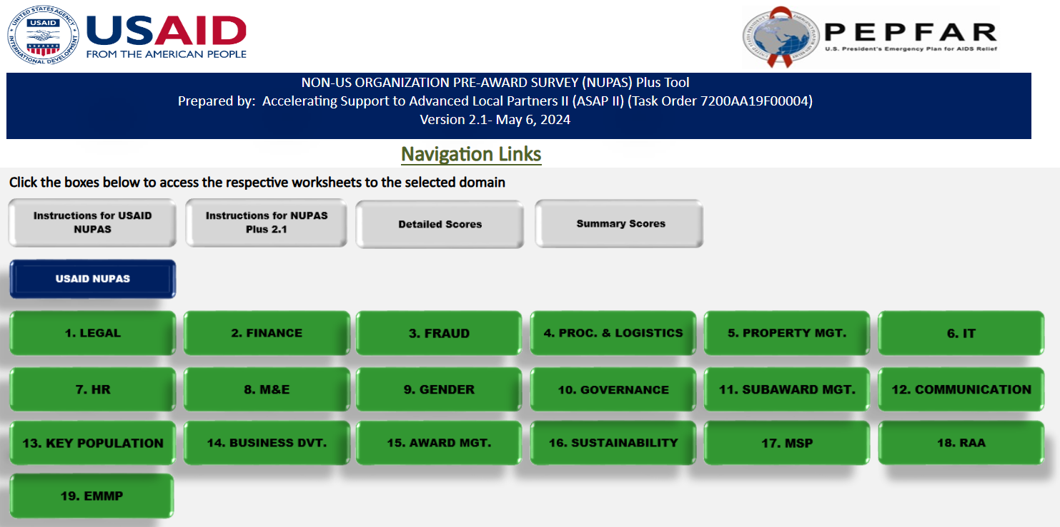
PRE AWARD SURVEY
Notes:
‹#›

Slide 20
EXAMPLE FROM ONE NGO
DETAILED SCORES
NUPAS
Domain and Categories |  | Score
1. Legal
1 | Definition of Local Organization | 4.00
2 | Compliance with Legal Requirements | 2.10
3 | Organizational Structure | 3.50
4 | Governance | 4.00
5 | Control Environment | 2.10
 | Average Score | 3.10
2. Finance
6 | Banking Relationship and Accounts | 3.25
7 | Accounting Bookkeeping System | 3.50
8 | Chart of Accounts General Ledger | 3.38
9 | Variance Analysis | 3.00
10 | Allowable and Unallowable Costs | 3.13
11 | Direct and Indirect Costs | 3.75
12 | Payments - Segregation of Duty | 4.00
13 | Accounting - Segregation of Duty | 4.00
14 | Financial Records Management | 2.75
15 | Sources of Funding | 3.33
16 | Financial Reporting | 2.50
17 | Audit and Review of Financials | 3.75
18 | Financial Management Personnel | 4.00
 | Average Score | 3.41
13

Slide 21
NUPAS DOMAIN | SUB-DOMAIN | RECOMMENDATIONS | ASSESSMENT SCORE (2024)
LEGAL | Taxes | Finalize the tax reconciliation and clear the longstanding tax arrears with the Uganda Revenue Authority. | 2
FINANCE | Accounting Policies and Procedures Manual | Review and update the Accounting Policies and Procedures Manual | 3
 | Accounting Policies and Procedures Manual | Organize refresher training sessions for staff in the areas of Finance for Non-Finance Managers, USG rules and regulations, and Risk Assessment and Management | 3
 | Indirect costs | The cost recovery plan should be updated to include strategies for recovering indirect expenses from projects. | 3
NUPAS Plus Risk Management | Organization Risk Assessment | Finalize the Risk Management policy and related Risk Management Framework | 2
 | Organization Risk Assessment | Develop a Fraud Risk Assessment tool to enhance TASO's ability to identify and mitigate fraud risks effectively. | 2
 | Organization Risk Assessment | Arrange certified training programs for the Internal Audit department staff focused on Risk Assessment and Management techniques, including identification of programmatic risks | 2
 | Organization Risk Assessment | Provide support to internal audit staff to fully understand the utilization of the audit analytics software, Audit Command Language (ACL), procured by the organization to facilitate their work on IT enabled systems | 2
 | Organization Risk Assessment | Conduct a quality review of the Audit, Risk, and Compliance Directorate to evaluate its effectiveness and identify areas for improvement. | 2

Slide 22
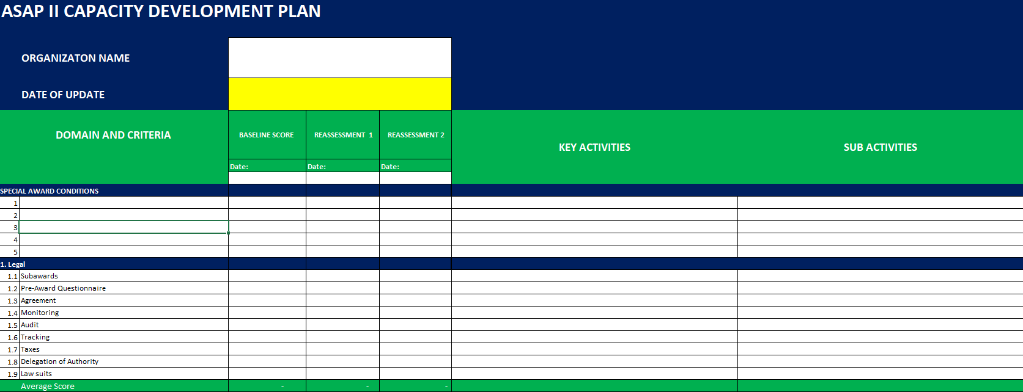
CAPACITY DEVELOPMENT PLAN

Slide 23
ISSUING AWARD
Verify acceptance of Individuals, Organizations
Conduct Organizational Risk Assessment
Decide about/Sign a Pre-Award Letter
Make sure the Sub has a UEI
Develop a Subcontract or Subaward with a clear Period of Performance and:
Statement of Work
Detailed Budget
Price justification
Insurance certifications
Subcontractor Reps & Certs
Secure Required approvals and Signatures
Completed waivers for payment terms, advances, and insurance as applicable

Slide 24
PROJECT START UP

Slide 25
POST AWARD MEETNG
Led by OAA
Opportunity for local organization to meet USAID team
Congratulate local organization on winning award
Understand roles and responsibilities
Emphasize reading the entire award is critical, suggest created a table of all requirements with who is responsible and deadlines
Review of USG Rules and Regulations
Provide time for questions and answers
Build relationship and emphasize USAID is available and willing to support the learning curve in managing a USAID award
Establish work preference
Confirm deadlines
Take Notes
Resource: https://www.usaid.gov/sites/default/files/2022-12/Post-Award-Conference-QRG.pd
f

Slide 26
TRANSLATIONS USAID RULES & REGULATIONS
Mandatory Standard Provisions (ADS 303mab)
Standard Provisions for FAA (ADS 303mat)
Pre-Award Terms (ADS 303mba)
Fixed Amount Award Entity Eligibility Checklist (ADS 303ma)
Fixed Amount Awards to NGOs (ADS 303saj)
Fixed Amount Agreement Template (ADS 308mai)
Fixed Obligation Grant Template (ADS 303sal)
Branding and Marking (ADS 320sab)
SAM UEI Translation Guidelines
SAM.gov Entity Validation Services
Model Letters for AORs (ADS 303mai)
Certifications, Assurances… (ADS 303mav )
Motor Vehicle Source and Waiver (ADS 312sac)
Financial Audit Guide (ADS 591maa)
NUPAS Guidelines and Support (ADS 303sam)
NUPAS tool (ADS 303sama)
Final Report Template (ADS 303samab)

Slide 27
TRANSLATIONS USAID RULES & REGULATIONS
Strategic Information
Y23-MER-2.6.1-Indicator-Reference-Guide.pdf
SIMS v4.2 Master Site Level CEE Library
USAID Evaluation Policy
PEPFAR Site Improvement Through Monitoring Systems
How-to Note: Activity, Monitoring, Evaluation Learning
Communications
Guide Photography Tips
Guidelines for submitting stories
USAID Style Guide Updated Nov 23
USAID_GSM-02-04-2020
USAID Photo Guide 2020
ASAP II Resources
ASAP II Subaward Management training manual
ASAP II Subaward Slides
ASAP II Leadership and Governance Training Manual
ASAP II Leadership & Governance Training Slides
NUPAS Plus 2.1 Tool
NUPAS Plus 2.1 Slides

Slide 28
Complexity of Procurement under USG/USAID
22 CFR 228 – Source and Nationality
USAID Standard Provisions
Anti-Terrorism Rules
Entity’s own policy
Cost Principles
Procurement
2 CFR 200
Procurement Standards
Ethical Standards & Conflict of Interest

Slide 29
USAID POLICY DOCUMENTS
USAID Anti-Corruption Policy
2020 USAID Policy on Promoting the Rights of Indigenous Peoples
USAID Graphic Standards and Partner Co-Branding Guide
Building Bridges in Development USAID's Strategic Religious Engagement
2023 USAID Gender Equality and Women's Empowerment
USAID Guidance on Child Safeguarding for Implementing Partners
2022 Youth in Development Policy
DRAFT 7: Nothing Without Us: USAID Disability Policy
This Policy is under revision (April 18, 2024)
2023 LGBTQI+ Inclusive Development
Inclusive Development – Additional Help for ADS 201

Slide 30
Start-up Deliverables
Annual workplan / annual budget
Monitoring, Evaluation and Learning Plan
Initial Environmental Examination - 22 CFR 216
Branding & Marking Plan - ADS 320.3.2
Grants Manual (if applicable)
Security and Safety Manuals
Other, as required per your award agreement

Slide 31
Critical Start-up Activities for Local Organizations
Ensure you have a qualified team to support the Start-up
Ensure proper registration is in place
Set up a separate, interest-bearing bank account for the project
Recruit staff, issue employment agreements, and onboard them
Conduct Staff and sub-Partners Technical, Admin/Finance & Compliance Onboarding
Create necessary manuals, plans and monitoring plans
Ensure that financial and procurement systems and policies are in place
Finalize subcontracts/sub-awards
Secure offices and complete office set-up, including IT, particularly access to the Internet
Request waivers or approvals from USAID
Procure equipment, supplies, and vehicles
Identify and secure any government/counterpart approvals needed

Slide 32
Best Practices Start-up for Local Organizations
Create a key clear start-up timeline: tasks tracker with key deliverables and deadlines
Start-up timeline captures: Recruitment, Operations, Procurement, Technical Activities
Establish a Start-up Team with clear roles and responsibilities for each team member
Designate a Start-Up Manager with responsibility and accountability for the success of the complete process
The Start-up Manager set-up recurrent meetings , send invites to Start-up team, preferably weekly-meetings at the beginning
Take and share notes with specific actions after each Start-up meeting
Document and share lessons learned during the start-up process

Slide 33
Local Organization recruitment
During a site visit, ask about the status of tasks and verify documents:
Create clear job descriptions
Advertise widely the positions
Avoid any types of discrimination: gender, religion, age, sex orientation, etc.
Recruit the right people for the right job
Have clear lines of supervision
Be competitive and provide the right compensation- Fair Market

Slide 34
What Characterizes a Well Implemented Project?
USAID Capacity Strengthening Activities
Be ready to provide additional support for local organizations to meet USAID standards
Provide training and technical assistance to support local organization
Consider budget to procure Grammarly or other software to finalize documents
Consider creating peer-to-peer networks for exchanging information
Local organization requirements
Good staff & partner management
Implementing project activities on time and within budget
Submitting qualitative reports
Communicating learning and success
Reliable M&E System
Achieving and measuring impact
Donor Satisfaction
Notes:
Eviter plusieurs M&E operant en parallele pour un seul projet

Slide 35
Work Plan Outlines
Acronyms and Abbreviations
Introduction
Summary of project purpose, achievements, opportunities and challenges, period covered
Operational Context
Issues and trends in the operating environment that have implications for implementation
Achievements/Impact
Discussion of progress against targets, achievements/impact to date, and lessons learned
Objectives and Planned Results for the Year
This includes discussing assumptions in place to achieve results.
Planned Activities
Schedule & Resources
Cover Page
Program Name
Activity Start Date and End Date:
Name of Prime Implementing Partner:
[Contract/Agreement] Number:
Name of Subcontractors/Subawardees:
Major Counterpart Organizations
Geographic Coverage (cities and or countries)
Reporting Period:
Submission Date:
Consider: Submission in preferred language and use USAID’s google form to request translations
Notes:
‹#›

Slide 36
)
Monitoring Evaluation Learning Plans (MEL)
Purpose:
Monitoring data helps USAID and its partners understand whether the activity is on track or adjustments are needed.
Evaluations answer critical questions related to the implementation or outcomes of the activity.
Learning means analyzing various information to inform possible adaptations needed to achieve programmatic objectives.
MELs are management tools that outline indicators, targets, and what data you will collect and how you will collect it to measure and showcase your impact
MELs cover the life of the project - they can only be revised if USAID has approved changes in targets or indicators
Ensure MEL aligns with national standard indicators

Slide 37
Local Partners’ Organizational Capacity Strengthening
During a Site Visit

Slide 38
How-To Note version 4 & ADS 201.3.4.10.B
CONDUCTING A SITE VISIT
Primary Drivers
Primary Drivers:
CORs/AORs
Other staff:
Activity Managers
Alternate CORs/AORs
Other Mission or Washington Operating Units Staff:
Program Office Staff
Support Office Staff
M&E Points of Contact
Learning Advisors

Slide 39
WHAT IS A USAID SITE VISIT?
Essential & required component of a Mission’s performance management.
Site visits are conducted by CORs/AORs, or any other USAID staff member and cover:
Monitoring
Oversight
Learning from activity implementation
Now we can add Capacity Strengthening

Slide 40
SITE VISITS
Visiting a location implementing an activity supported by USAID
Visit the Implementing partner’s local office AND Service Delivery Sites
Review performance results compared to workplan
Observe training or other events funded within USAID activity
Talk to beneficiaries to get feedback
Conduct data quality assessments
Review organizational assessment and verify progress
Example: “Organization’s Board of Directors must sign Conflict of Interest Forms” Ask to see the signed forms of all Board Members.
Example: “Develop a Financial Management Manual which includes segregation of duty”. Ask to see the manual, check section on segregation of duties and SPOT check some transactions such as procurement.

Slide 41
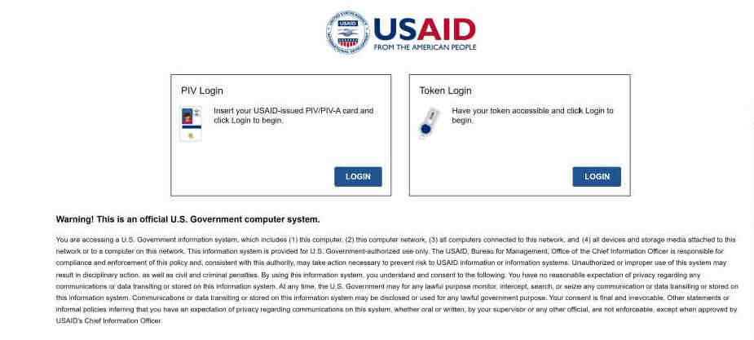
AGENCY REQUIREMENTS FOR SITE VISITS
Mission and the activity’s context should inform the number and frequency of site visit, in general, at least once every six months for each activity
Site Visits should occur more frequently for poor-performing activities: Agreements or awards with audit or evaluation findings identified moderate or high risk for waste, fraud, or abuse
Non-Permissive environments: Missions may use remote methods to conduct site visits (ADS 201.3.4.10.B)
The Bureau for Policy, Planning, and Learning (PPL) recommends that the Mission Director or his/her designate determines the minimum number and frequency of site visits per activity in a Mission ( ADS 201 performance monitoring requirements)

Slide 42
WHAT IS NOT A SITE VISIT
1. Routine COR/AOR meetings with the implementing partner.
2. Visiting a site without a purpose and without documenting findings in a site visit report.

Slide 43
SITE VISIT REPORT
Reporting a Site Visit:
A brief report highlighting the findings from a site visit must be written
Within 30 days of a site visit- Report filed in the official award file using the Agency Secure Image and Storage Tracking system (ASIST).

Slide 44
CORs/AORs CHECKLIST FOR A SITE VISIT
Determine the Purpose (s)
Consider the current status of activity implementation
Identify expectations from award doc, work plan, MEL plans, Mission’s PMP, progress reports
Verification of Capacity Strengthening activities
IP raised concerns/Lingering issues
Identify the Site Visit Team
Promote collaboration across the Mission; determine who should be included, such as the CO/AO, M&E POC, Learning Advisor, Finance Analyst, Localization POC etc.
Plan the Visit
Determine methodology: Observations, interviews, document reviews, DQA, roundtable discussions, informal discussions for relationship management
Select capacity strengthening areas to address
5. Select the Site (s), considering
Staff Availability
Geographic location
Climate patterns
IP and Stakeholder availability
Security (Checking with RSO)
Schedule the Site Visit
Which is convenient to all parties

Slide 45
FINANCIAL MANAGEMENT

Slide 46
Revision of Budget and Program Plans
Prior approval is needed for:
Changes in the scope or the objective of the program (even if there is no cost impact)
Key personnel changes or the disengagement from the project for more than three months or a 25% reduction in time devoted to the project
Transfer of funds budgeted for participant support costs to other categories of cost
Subawards
Changes in cost share

Slide 47
Cost Principles – 2 CFR 200 (Subpart E)
Allowable: Is it necessary for successful performance? Is it in compliance with the award? Is it within the period of performance? Does it follow generally acceptable accounting standards? Is it adequately documented?
Reasonable: Is it what a prudent person would have paid? Is it in line with the market practices? Is it the best value when you compare with alternatives? Is it incurred in line with your Organization policies?
Allocability: Is it incurred specifically for the award? If shared with another project is the % allocated to the award fair?
The U.S. Government’s (USG’s) Cost Principles determine what costs can be incurred and charged to a project that is funded by the USG
Notes:
also known as Uniform Administrative Requirements or Uniform Guidance (UG)

Slide 48
Types of costs: Allowable- Restricted – Prohibited or Ineligible?
Allowable
Per an operating country’s laws, USAID regulations, and Partnering Organization’s policies.
Restricted
Allowable, but only with prior USAID approval.
Prohibited or Ineligible
Not allowable under any circumstances using any portion of USG funds.
Notes:
Question: Est-ce il peut avoir des conditions pour l’acquisition des biens ou services prohibes ou ineligibles?
Tout ou Rien
Si Country law- Make sure that applies to USAID-funded projects

Slide 49
Program Income
Program income = revenue directly generated by a program-funded activity during the program’s period of performance
Program income does not include interest earned on advances, rebates, credits, or discounts unless the terms and conditions of the award stipulate otherwise
The Recipient must account for program income following 2 CFR 200.307
Program Income Can Be Generated From:
Fees for services performed
Goods that are sold with USAID approval
Rental of property
Notes:
Les revenus du programme sont les revenus que votre projet génère directement pendant la période d'exécution. Il peut s'agir des intérêts gagnés sur les prêts de microcrédit que vous accordez dans le cadre de votre projet, de la vente de marchandises ou d'autres biens, etc. Les revenus du programme n'incluent PAS les intérêts gagnés sur les avances, les remises, les crédits ou les remises.
Une autre chose très importante à noter concerne les revenus du programme provenant des droits de licence, des redevances pour le matériel protégé par le droit d'auteur, des marques déposées et des inventions réalisées dans le cadre d’un financement fédéral si elles sont soumises au 37 CFR partie 401.

Slide 50
Options for Managing Program Income
Three options for how to handle any income generated from a USAID-funded project:
1. Deduct it from the total award amount
2. Add it to the award (default for non-U.S. organizations)
3. Use it to meet a cost-share requirement
These do not apply to income from license fees and royalties for copyrighted material, patents, trademarks, and inventions.
If program income is anticipated to be generated under the award, the AO will indicate how that income will be treated under the award
Notes:
You have three options for how you can handle program income that you generate on your USAID-funded project:
You may deduct it from the total award amount
You may add it to the award (which is the default for non-U.S. organizations)
You may use it to meet a cost-share requirement. If you do this, it must be considered eligible cost share, as per USAID’s rules and regulations.
After the last day of the project’s period of performance, you can keep any income that you generate on these activities.

Slide 51
Cost Share
Any cash or in-kind resources donated to a project by a third party to help achieve award objectives
A liability (if required on your award) and any unmet obligation may be deducted from your total award amount
The source of funds by the third party cannot be from any USG agency, i.e., another project funded by the USG
Cost Share is subject to audit!
Notes:
Let’s start with resources

Slide 52
What is an Eligible Cost Share?
To be considered eligible cost share, a cost must:
Be paid by funds that are NOT provided by a U.S. Government agency
Be considered as cost-share on only one project
Be verifiable through documentation which describes the date, source, amount, and purpose
Be necessary, reasonable and allowable, as per USAID guidelines
Directly contribute to the objectives of the project
Appear in your approved budget
Notes:
Examples:
Donated equipment or materials
Volunteer labor
Free radio airtime/newspaper coverage
Donated space for project use
Cash donations

Slide 53
THANK YOU!
Cette publication a été rendue possible grâce au soutien du peuple américain par l'intermédiaire de l'Agence des États-Unis pour le développement international (USAID) et du Plan présidentiel d'aide d'urgence à la lutte contre le sida (PEPFAR). Son contenu relève de la seule responsabilité d'IntraHealth International et ne reflète pas nécessairement les opinions de l'USAID ou du gouvernement des États-Unis.

