Slide 1
Presented by: USAID Burundi Office of Acquisition and Assistance
Katie Larson, Contracting and Agreement Officer
Szidonia Sezekeres, Sr. A&A Specialist
Liliane Gatunange, A&A Specialist

Slide 2
AGENDA
About USAID's Mission and Work in Burundi
OAA and Localization
Partnering with USAID
WorkwithUSAID.gov Walk-Through
Staying Connected
Q&A
Notes:
-About USAID’s work in Burundi
-Dos and Irs Overview
-Partnering with USAID
-How we Fund
-Where to find opportunities
-When you are applying Tips/Advice
-WorkwithUSAID
-Go through main tabs and explain what the resources are and top lines about why its helpful
-Staying Connected
-What they can do now to keep learning and staying in touch with USAID
-Q&A
-Open discussion

Slide 3
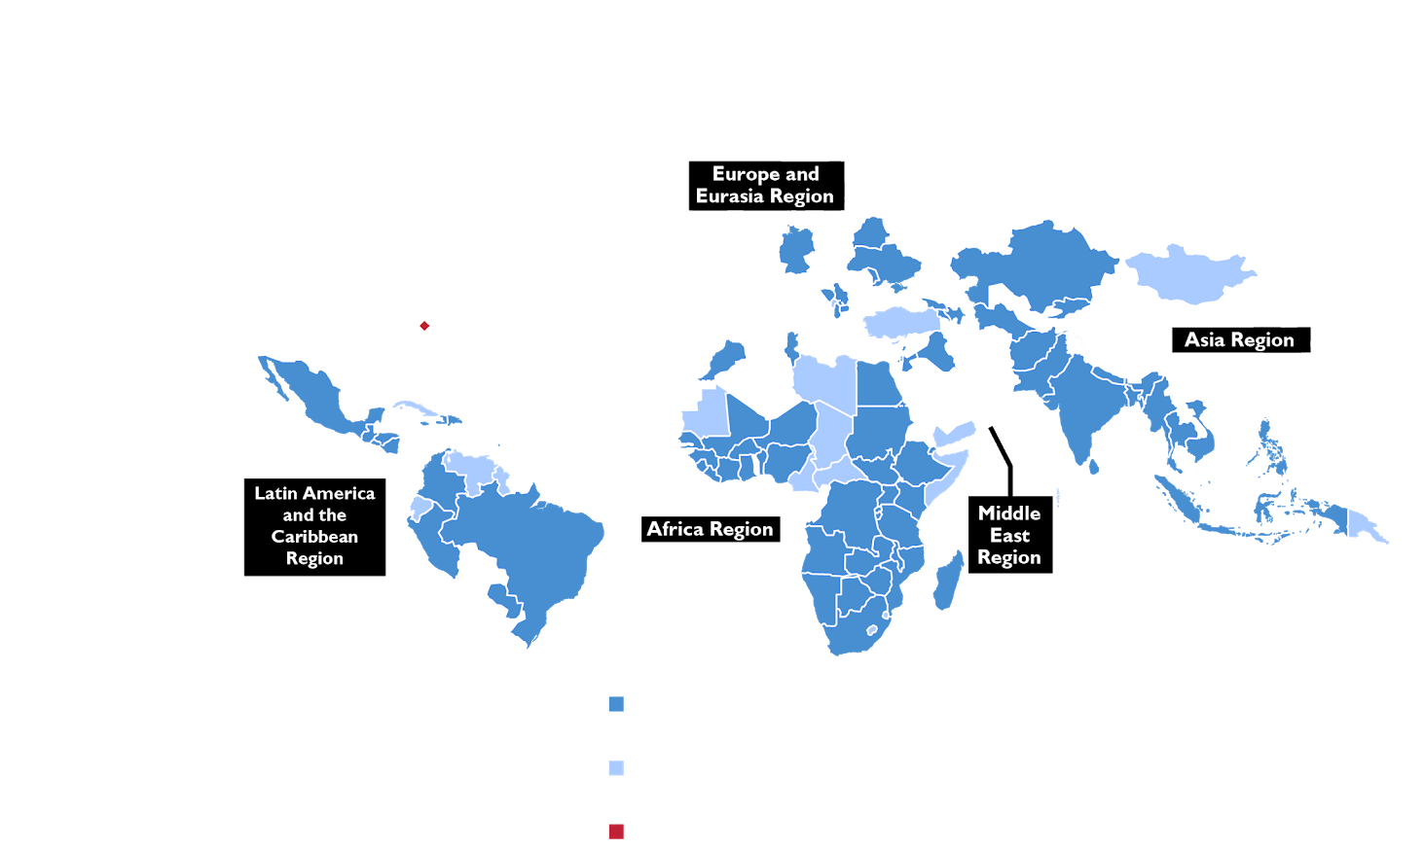
USAID’s MISSION
We promote and demonstrate democratic values abroad and advance a free, peaceful, and prosperous world.
Our team of 9,000+ serves in over 100 countries around the world. Our workforce and culture reflect core American values-and an unwavering commitment to do the right thing.
Notes:
USAID, like any organization, has its unique history, culture, and ways of doing business. This is important information for you to understand as you think about becoming a partner of USAID.
The United States is the world’s largest donor of foreign assistance.
Development takes its place alongside defense and diplomacy as the three essential pillars of American foreign policy.
We are extending help from the American people to the most vulnerable people in the world.
The Agency carries out U.S. foreign policy by improving the lives and well-being of people living in poverty and, at the same time, expanding democracy and promoting free markets.
Although our work is separate from political and military assistance, USAID programs address both security and development objectives.
To do this, we have a Global USAID Team that works in more than 100 countries around the world.
We have around 9,000 staff who are organized in three major categories:
Approximately 1,800 Foreign Service Officers, who are U.S. citizens that work at overseas posts worldwide
Approximately 1,200 Civil Service employees, who are U.S. citizens who work for the Federal Government in Washington D.C. and throughout the U.S.
Our largest group of employees are our 6,000 Foreign Service Nationals, who work at USAID in our global offices, but who are citizens of their respective countries.
Finally, we also have US citizens who are contractors who work overseas as well as Third Country Nationals who are non-U.S. citizens that work in a country other than their home country.
In Burundi, we have a Team of 20 - including 3(+1 Kigali) Foreign Service Officers, 2 US Contractors, and 15 Foreign Service Nationals,
So what does our Team of 20 do in Burundi?

Slide 4
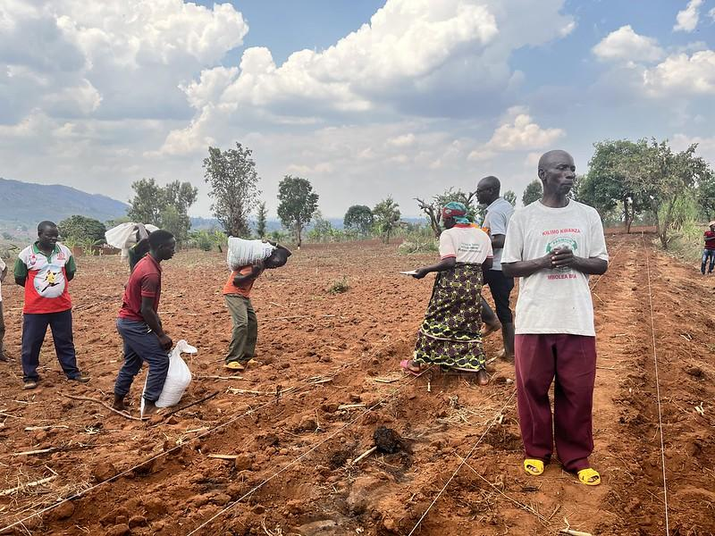
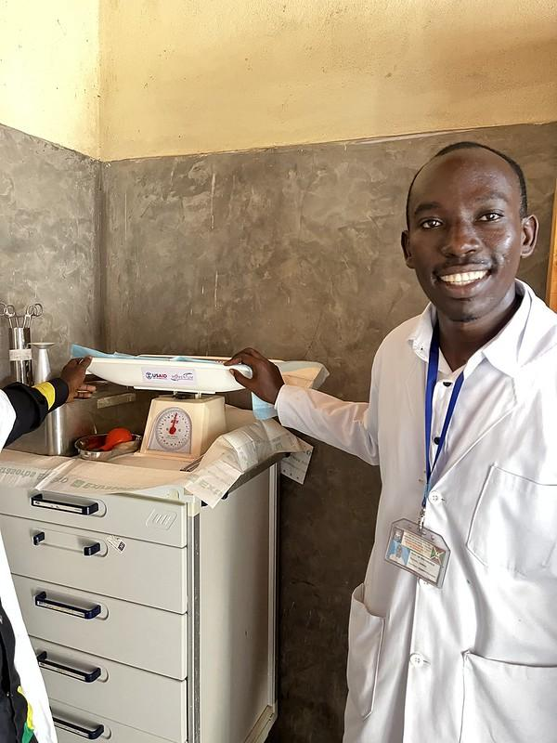
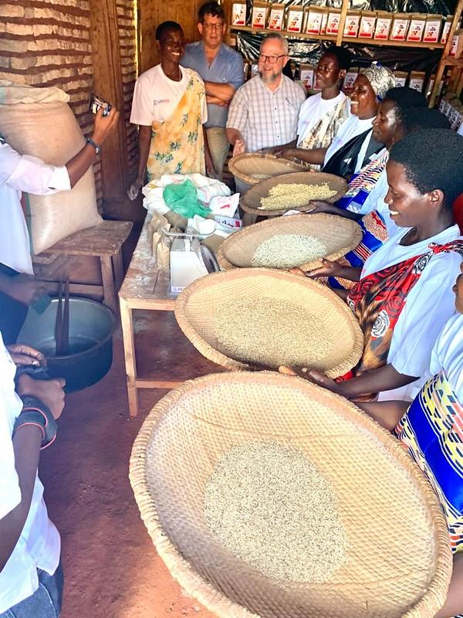
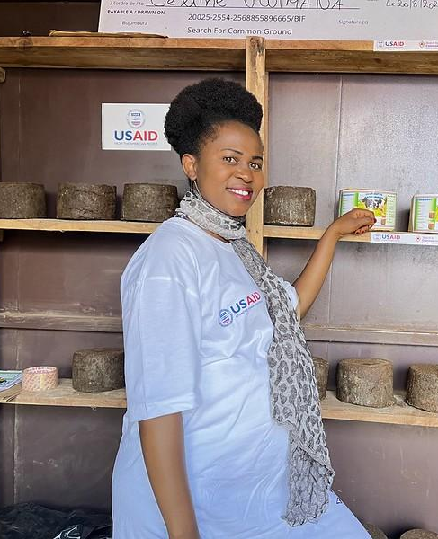
USAID’s WORK in BURUNDI
10 bilateral awards (5 to local organizations) | $20.2M = ~22% of funding to local orgs.
Enhancing Sustainable Livelihoods
Quality Health Services and Systems Bolstered
Agriculture Market Systems Strengthened
Building Public Trust
Accountable Governance Strengthened
Advocacy for Democratic Reform and Human Rights Promoted
Notes:
Here in Burundi, our work improves lives in a variety of ways, such as:
DO 1: USAID activities under DO 1 support the foundations for sustainable development in conjunction
with Burundi’s National Development Plan and its focus on Strengthening Food Self-Sufficiency and
Diversifying Exports; Protecting the Environment, Adapting to Climate Change and Improving Land
Use Planning; and Developing Regional and International Partnerships.
DO2: USAID prioritizes work to counter human rights violations, including trafficking in persons;
enhance conflict mitigation and stabilization interventions; and mobilize citizen engagement. USAID
will works to enhance the environment of stability and build on current activities that seek to
promote peace and reconciliation, i.e., bridging social divisions; expand civil space, strengthen the
capacity of the private sector and civic society so that they are better equipped for advocacy; and
reopen the channels of dialogue between the citizens and an accountable governance that respects
the protection of human rights.

Slide 5
Who is the Office of Acquisition and Assistance?
The contract and grant making arm of USAID that provides business and development advice to USAID technical teams from design to award phase as well as regulatory guidance throughout implementation.
Reducing barriers to entry for local partners.
Increased Outreach to Local Partners
Translation of Requests for Information, Solicitations, and Award documents and SAM & UEI documents
Conduct Pre-Application/Proposal Conferences in English and Local Languages
Use of mechanisms with lower compliance burdens
Streamline Procurement Approaches: Concept notes, Co-Creation, Phased Acquisition, Oral Presentations
Flexible pre-award assessments for local partners
Notes:
As the office that obligates USAID funding to our partners, its important to have a general understanding of where our funding comes from to do our work.

Slide 6
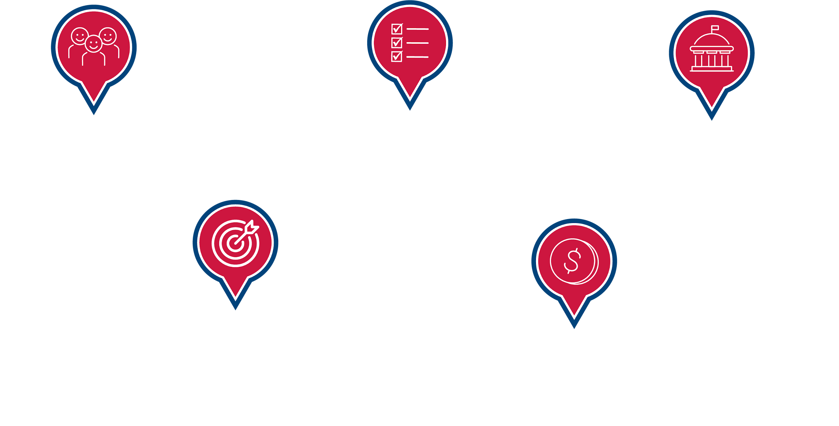
How We Fund Our Work
Notes:
Next, let’s have a quick overview of the USAID budgeting process, showing how we fund our work around the world.
USAID is funded by the American people. In the U.S. government system, while the President proposes a budget, the Congress decides the final budget for the federal government. USAID staff work with both Congress and the Executive Office of the President to determine the Agency’s budget priorities.
At the same time, USAID missions and offices develop country strategies to identify specific programs and activities. In Burundi, the Strategic Framework guides USAID Burundi’s priorities.
It’s also important to know that USAID awards the majority of its funds through a competitive process, which is part of what my colleague Szidonia will get into later in our session as well as some tips and advice for applying to opportunities.

Slide 7
Our Operating Framework
PROGRAM CYCLE
Guiding framework
POLICIES, STRATEGIES, FRAMEWORKS, AND VISIONS
Analysis and evidence
COUNTRY DEVELOPMENT COOPERATION STRATEGIES (CDCS)
Country-specific planning
AUTOMATED DIRECTIVE SYSTEM (ADS)
Operating policies and procedures
Notes:
Before we do that, though, it’s good to know about USAID’s operating framework.
The Agency has a tool called the Program Cycle that links everything we do -- from policies to strategic planning to project design to implementation to monitoring and evaluation to how we incorporate lessons learned back into our policies.
In addition, in Washington, we develop a series of policies, strategies, frameworks, and visions that guide how we work.
For example, we have a “Global Water Strategy” that outlines how we will implement water programs around the world.
Each Mission at USAID, as mentioned earlier, has its own Country Development Cooperation Strategy, known as the CDCS.
The CDCS governs USAID’s work locally in that particular country and is typically a 5-year strategy that outlines all of their goals in the different technical areas.
The Burundi Mission is a regional office within the USAID Rwanda Mission, therefore, USAID Burundi development priorities are defined in the Strategic Framework (as covered this morning).
The Strategic Framework is a really great resource for new partners to understand.
Finally, the Automated Directives System, or better known as the ADS, contains and documents the Agency’s operational policies and procedures.
As you’ll learn later, when responding to a request for proposals or a request for applications, incorporating all these documents into your approach and into your plans will help increase the likelihood of receiving funding from the Agency.

Slide 8
USAID POLICY & REGULATORY FRAMEWORK
ACQUISITION (CONTRACTS)
Competition in Contracting Act of 1984
Federal Acquisition Regulations (FAR)
USAID Acquisition Regulation (AIDAR) complements the FAR
ASSISTANCE (COAG/GRANTS)
1. The Federal Grant and Cooperative Agreement Act of 1977
2. Code of Federal Regulations: Grants and Agreements - 2 CFR 200, 2 CFR 700
ADS 302 ADS 303
See “Funding Essentials” page on WorkwithUSAID.gov
Notes:
I won’t go into depth on the regulatory framework for what governs acquisitions (contracts) versus assistance (coags or grants). But I do want to point out that while USAID ADS operating policies and procedures applies to both,
The FAR governs a federal government process called acquisition and is supplemented by USAID acquisition regulations in the AIDAR.
The FAR is a rule book that most agencies of the federal government have to follow when acquiring goods and services through the use of procurement contracts. For example, the FAR generally requires agencies to obtain “full and open competition” when soliciting offers and awarding contracts.
The Code of Federal Regulations is what we follow when we issue grant or cooperative agreements to help support a project.
Now, I will hand it over to my colleague Szidonia, who will go over the key phases of the award process - regardless whether its a contract or grant.

Slide 9
KEY PHASES OF THE AWARD PROCESS

Slide 10
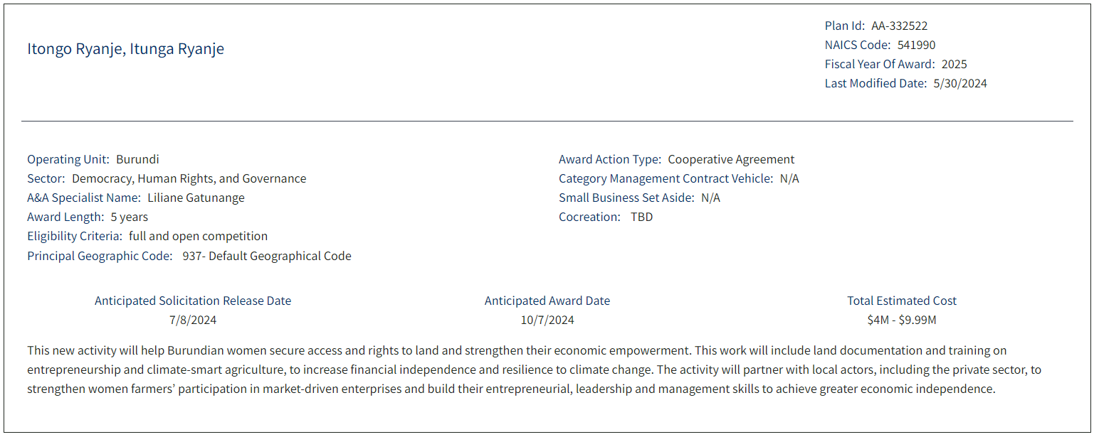
USAID BUSINESS FORECAST
The latest information about current and future funding opportunities updated daily.
Search open and planned opportunities through different filters, including sector, location, and award types.
https://www.usaid.gov/business-forecast

Slide 11
New to USAID? Look Out for These!
Request for Information (RFI) – Sources Sought Notice (SSN) – Draft Scope of Work
Notices of Funding Opportunities and Annual Program Statements or Requests for Proposals
USAID-Sponsored Events such as Industry Days
WorkwithUSAID.gov/events
Notes:
Bianca:

Slide 12
FUNDING
HOW WE AWARD OUR FUNDS
ACQUISITION
The purchase of goods and services through a contract.
ASSISTANCE
Financial support from the U.S. Government to an organization, through a grant or cooperative agreement to help carry out a project that benefits the community.
FIND FUNDING OPPORTUNITIES
SAM.gov
USAID contracts available for bidding are posted as Requests for Proposals (RFPs).
GRANTS.gov
USAID cooperative agreements and grants are posted as Notices of funding Opportunities (NOFOs).
See “Funding Essentials” page on WorkwithUSAID.gov
Notes:
-The majority of the Agency’s funds are awarded through competitive process
-M/OAA launched a Funding Essentials page on WorkwithUSAID.gov that provides baseline information to partners, such as understanding Acquisition and Assistance, exploring the Agency Business Forecast, reviewing Country Development Cooperation Strategies (CDCS), and existing funding opportunities through SAM.gov, Grants.gov, and the Sub-Opportunities portal.

Slide 13
COST TYPE AND FIXED-PRICED AWARDS
HOW THE PARTNER GETS PAID
COST TYPE
USAID reimburses the expenses an implementing partner incurs for the purposes of the program or activity
FIXED-AMOUNT/PRICE
USAID pays pre-agreed and fixed amounts for milestones and associated deliverables with well-defined requirements.
UNDERLYING CONSIDERATIONS
Expenses cannot be fixed in advance.
Specific interventions are planned annually.
Responsibility includes review of internal controls.
The deliverable remains unchanged during the award and can be priced in advance.
Focus is on performance.
The implementing partner shall meet minimum standards of responsibility.
Notes:
-The majority of the Agency’s funds are awarded through competitive process
-M/OAA launched a Funding Essentials page on WorkwithUSAID.gov that provides baseline information to partners, such as understanding Acquisition and Assistance, exploring the Agency Business Forecast, reviewing Country Development Cooperation Strategies (CDCS), and existing funding opportunities through SAM.gov, Grants.gov, and the Sub-Opportunities portal.

Slide 14
ARE YOU REGISTERED?
To be eligible to apply for U.S. funding (grants or contracts), entities need to obtain two registrations:
SAM: System for Award Management, Unique Entity ID (a 12-character alphanumeric ID assigned to an organization).
CAGE or NCAGE:
Commercial and Governmental Entity (CAGE) five-digit code—for U.S. entities—automatically generated by SAM
NATO Commercial and Government Entity (NCAGE) five-character code—for non-U.S. entities—required before registering for SAM
Non-U.S. entities only interested in grants or cooperative agreements DO NOT need an NCAGE code
Start this process early, see USAID YouTube Channel demo in French on how to register in SAM.gov!
Notes:
-USAID Translation Program - SAM UEI Documents [M/OAA At a Glance - May 30, 2024]
-When pursuing their SAM UEI registration, local partners must undergo an entity validation process that requires them to submit certain legal documents. A challenge for many local entities is that these documents must have an English language translation attached when submitted in SAM.gov. USAID’s Translation Program now offers a translation service for these documents. This service is available only to apparently successful applicants. The Translation Program’s Frequently Asked Questions contain additional information. Agreement Officers may make a request for translation support here. I hope that this will significantly reduce the burdens on our local partners and reduce delays.
-Stress that obtaining SAM.gov and UEI takes time to complete. Start the process early.

Slide 15
TIPS FOR SUBMITTING A PROPOSAL OR APPLICATION
Get SAM.gov registered and a UEI, and start early! It takes time.
Read the entire solicitation carefully
Ask questions by sending them during the “open question period” to the listed point of contact.
Follow the instructions outlined in the solicitation
Create a strong proposal by demonstrating your technical expertise, past performance, and ability to accomplish the work
Be specific—do not let USAID make assumptions
Consider partnering with an organization that has experience working with USAID

Slide 16
ARE YOU A RESPONSIBLE APPLICANT/OFFEROR?
To be eligible to apply for U.S. funding (grants or contracts), USAID conducts a pre-award risk assessment to determine if entities:
Have the necessary technical capability to perform the activity/program
Have adequate financial resources or the ability to obtain such resources, as required during the performance of the activity/program
Have the ability to meet the award terms and conditions, considering all existing prospective recipient commitments
Have a satisfactory record of performance
Have a satisfactory record of business integrity
Is otherwise qualified to receive an award under applicable laws and regulations.
Cost reimbursement: has adequate policies, procedures and internal controls.
For first time direct recipients of cost-type awards, USAID conducts a pre-award survey.
Notes:
-USAID Translation Program - SAM UEI Documents [M/OAA At a Glance - May 30, 2024]
-When pursuing their SAM UEI registration, local partners must undergo an entity validation process that requires them to submit certain legal documents. A challenge for many local entities is that these documents must have an English language translation attached when submitted in SAM.gov. USAID’s Translation Program now offers a translation service for these documents. This service is available only to apparently successful applicants. The Translation Program’s Frequently Asked Questions contain additional information. Agreement Officers may make a request for translation support here. I hope that this will significantly reduce the burdens on our local partners and reduce delays.
-Stress that obtaining SAM.gov and UEI takes time to complete. Start the process early.

Slide 17
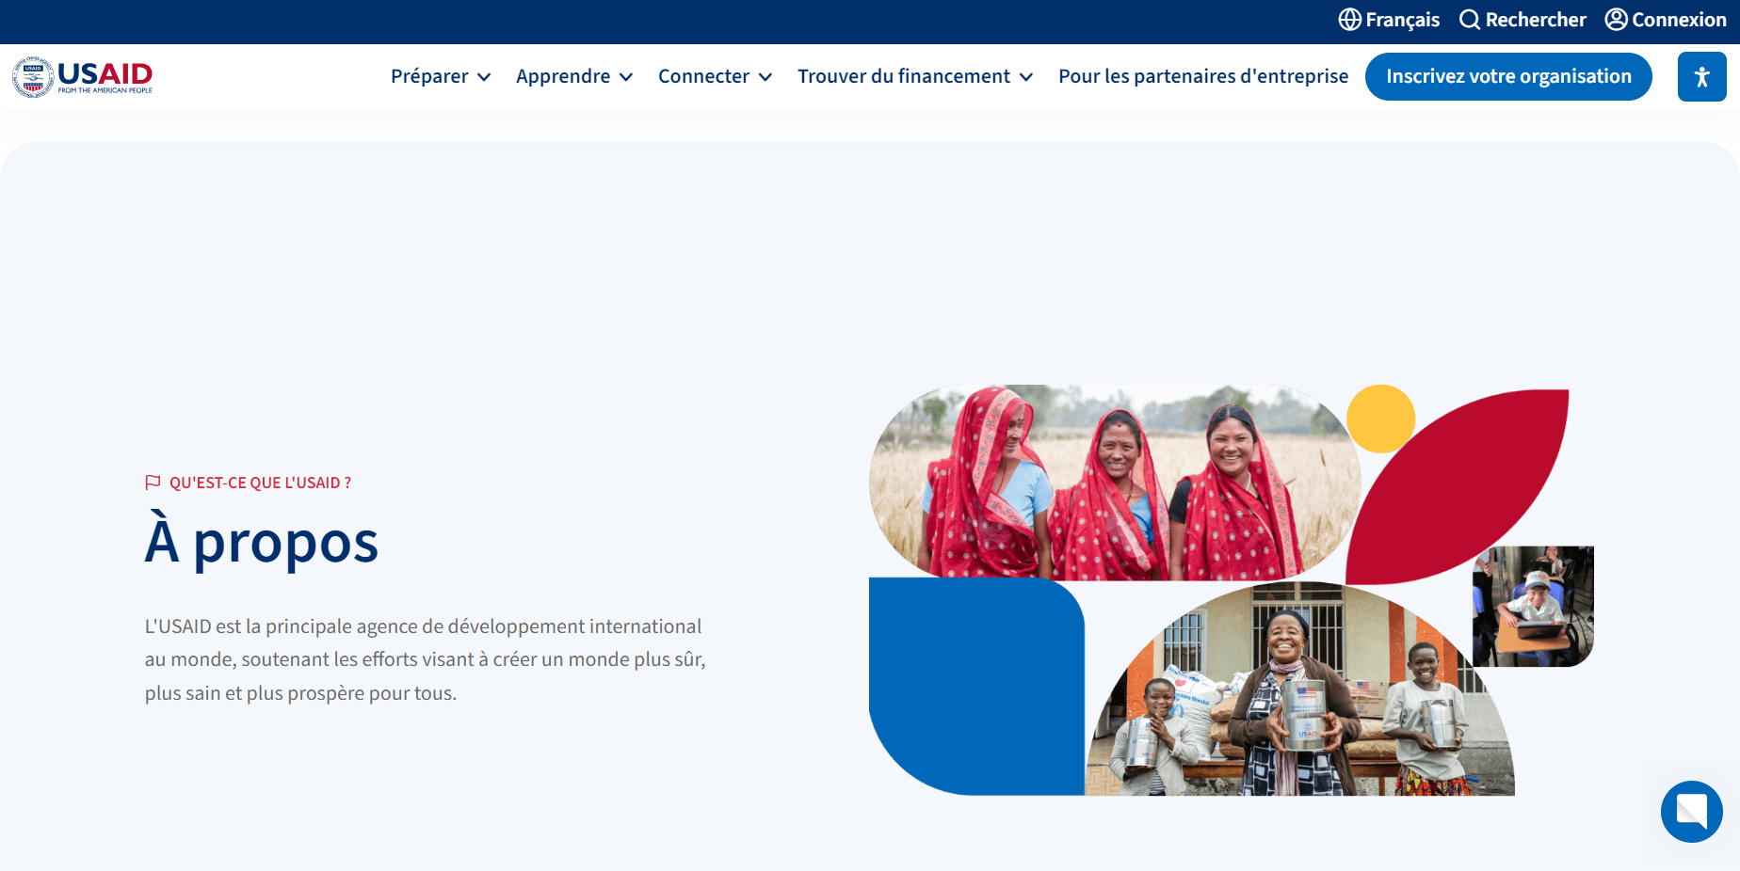
EXPLORE WorkwithUSAID.gov (Available in French)
Notes:
Go Briefly through tabs and the Resources available
-Prepare
-Learn
-Connect
-Find Funding

Slide 18
10 ACTIONS YOU CAN TAKE
1. Download the Partnership Checklist
2. Join the Partner Directory
3. Take the Pre-Engagement Assessment
4. Build your capacity through our library resources
5. Attend USAID partnership events
6. Check for funding opportunities, including the funding feed + sub-opportunities
7. Gain partnering insights on the blog or submit a guest blog
8. Visit USAID’s YouTube Channel
9. Join the Work with USAID LinkedIN group
10. Subscribe to the Work with USAID newsletter
Notes:
1.
2.
3.
4.
5.
6.
7. Send our blog to your network to help them familiarize their organization with these six steps to understand how to become a USAID prime partner. This blog is full of engaging resources to start organizations' path to partnership and to take the first steps toward becoming a prime. Read this blog here
8. This is a great resource to help you navigate partnering with USAID. The YouTube channel contains playlists where you can find videos specific to your needs. “Resources on WorkwithUSAID.gov” holds demo videos to help you explore the WorkwithUSAID.gov platform. You can also view recordings of webinars like the Business Forecast and Partner Updates webinars to better understand the Agency’s priorities and the How to Work with USAID 101 webinars to learn how USAID approaches funding. Also, check out our video resources in French, Arabic, and Spanish!
9.
10.

Slide 19
Spotlight Resources and Events to Get Started
Blog “How to Become a Prime”
YouTube videos in French!
Learn about USAID Funding Essentials
WorkwithUSAID.gov Partner Directory Registration Demo
WorkwithUSAID.gov Resource Library Demo
Upcoming Event “FY 2024 Third Quarter USAID Business Forecast and Partner Update Webinar”
Training Series on “How to Work with USAID”

Slide 20
QUESTIONS?

Slide 21
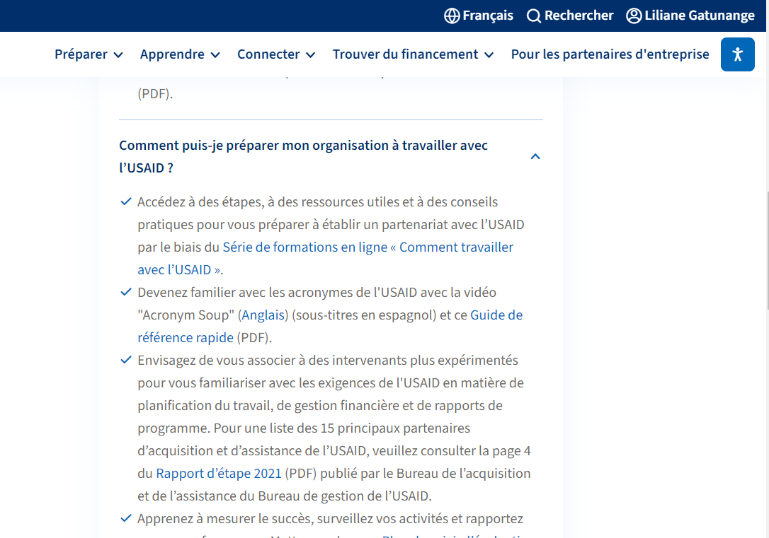

Slide 22
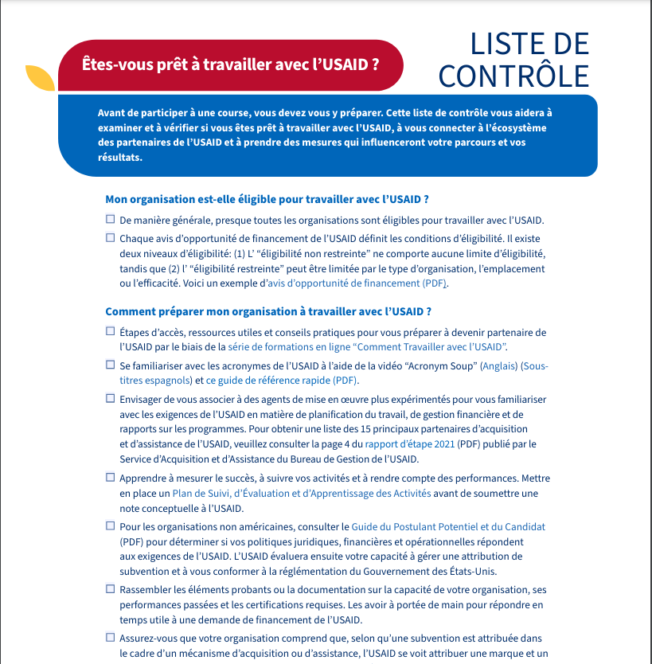

Slide 23
