Slide 1
USAID’S ACCELERATING SUPPORT TO ADVANCED LOCAL PARTNERS II (ASAP II)
CLOSEOUT WEBINAR
September 24, 2024
PROJECT DURATION:
May 31, 2022 – October 31, 2024
Notes:
Note: this session will be recorded

Slide 2
WELCOME ALL
Please let us know where you are from in the chat.
Please use the Q&A box to ask questions and the chat box for answering questions asked by the presenters.
We have one poll during the webinar today.
The presentation for today’s webinar will be saved on ASAP’s website at www.intrahealth.org/asap-resources

Slide 3
UPCOMING WEBINARS
September 24: ASAP II Closeout Webinar “Path to Prime and Road to Sustainability
September 30: Portuguese PEPFAR Expenditure Reporting Requirements
October 1: French: PEPFAR Expenditure Reporting Requirements
October 2: Portuguese PEPFAR Human Resource for Health Reporting Requirements
October 3: French PEPFAR Human Resource for Health Reporting Requirements

Slide 4
AGENDA
1. USAID Localization: Where We Started and Where We Are Now
Debbie Kaliel, USAID Office of HIV/AIDS, COR for ASAP
2. ASAP II Achievements and Legacy Tools for Local Partners
Catherine Brokenshire Scott, ASAP II Project Director
3. Story of Organizational Growth: Integrated Services for Health Development Organization (ISHDO)
Video
4. Capacity Strengthening Support through Organizational Assessments and Financial Management
Andrew Kigozi, ASAP II Senior Capacity Advisor for Financial Management and Compliance
5. Organizational Strengthening for Board Sustainability
Petronella Mwasandube, ASAP II Senior Capacity Advisor for Governance and Leadership

Slide 5
LOCALIZATION: WHERE WE STARTED AND WHERE WE ARE NOW
ASAP II Closeout Webinar
Debbie Kaliel, USAID Office of HIV/AIDS
September 24, 2024

Slide 6
“Move to local partners is critical and must be at 25% by the end of FY18,
40% at the end of FY19, and 70% by the end of FY20”
-- Global AIDS Coordinator Ambassador Birx
April 2018

Slide 7
WHAT WHERE THE RISKS
TO SUCCESS….
USAID Staff
Fragmented staffing across offices- needed a “whole of Mission approach”: LOE across Health, OAA, OFM teams
Insufficient staff: needed to increase # of staffing to provide oversight
Need specialized skills: Designated Local Partner Advisor Positions
Local Capacity
Worry about the capacity to manage USAID awards and achieve PEPFAR targets: needed dedicated mechanisms both central and bilateral supporting Local Partner Transition
Cross Mission Learning
Individual missions had good models but needed to share more across countries and programs: Mission wanted to learn from each other how to approach work with Local Organizations
Lack of Flexibility
Needed more flexibility: Importance of being flexible and adjusting in response to context and reexamining USAID policy and process barriers

Slide 8
USAID RESPONDED THROUGH ASAP I AND II:
Strategic Objective #1: Strengthen Local Partners as they transition to receive PEPFAR funding as a USAID Prime Partner to comply with regulations.
Strategic Objective #2: Prepare Local Partners to directly manage, implement, and monitor PEPFAR programs, and maintain consistent PEPFAR program achievement and quality.

Slide 9
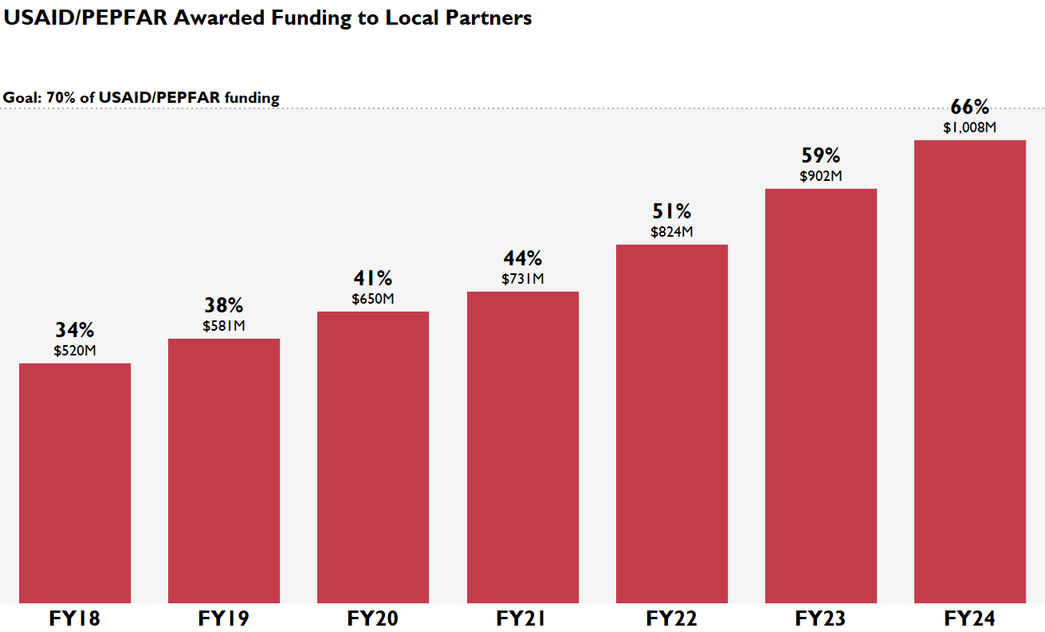
Majority of USAID’s HIV funding is now going directly to local organizations and partner governments
2024 | Estimated over $1 billion of bilateral HIV funds going directly to 214 local entities
FY24 USAID
66%
of USAID/PEPFAR program funding is through Local Partners
Percentages exclude GHSC-PSM/RTK and M&O
Source: Standard COP Matrix (as of 3/4/2024) and internal records on TBDs.

Slide 10
Local partners are supporting over two-thirds of all USAID supported PLHIV with clinical services
66%
65%
74%
66%
71%
228K / 347K
211K / 327K
5.4M / 7.3M
2.85M / 4.3M
590K / 829K
(Local Partner / USAID)
(Local Partner / USAID)
(Local Partner / USAID)
(Local Partner / USAID)
(Local Partner / USAID)
People who received HIV Testing Services (HTS) & received positive results
People newly enrolled on ARV treatment
Antiretroviral treatment (ART) for women, men, & children
Dispensed multi -month (3+ month) ART for women, men, & children
People on ART who started TB Preventive Treatment
FY24 cumulative results. Source: MER Structured Dataset, FY24Q2 Clean.
Notes:
Talking Points
USAID Local Partners are crucial to success of all these services and currently support over two-thirds of USAID-supported PLHIV with clinical services
Through Q2 of FY24, PEPFAR local partners have supported 74 percent of all individuals receiving ART.
66% of both multi-month drug dispensing and newly enrolled individuals on ARV have been managed by local partners.
Further, 71% of ART recipients starting preventive treatment for TB have been managed by local partners.
So, we see that local partners have taken responsibility for an increasing volume of HIV services, and we expect this trend to continue.

Slide 11
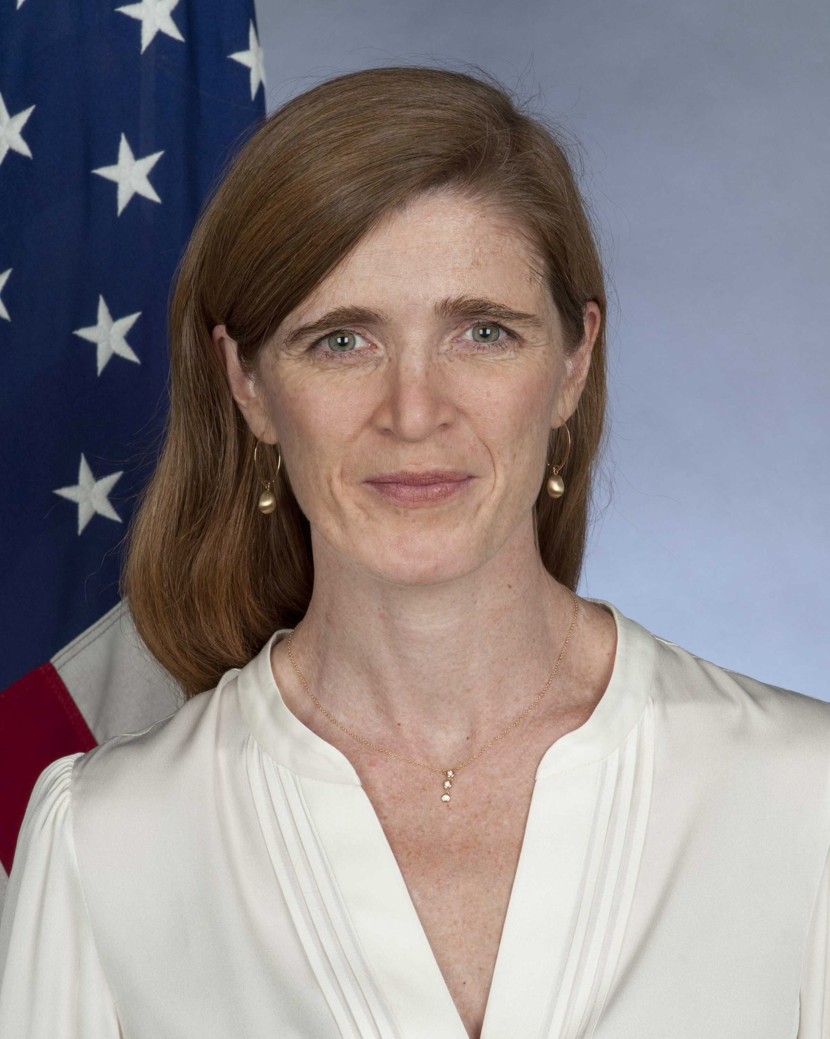
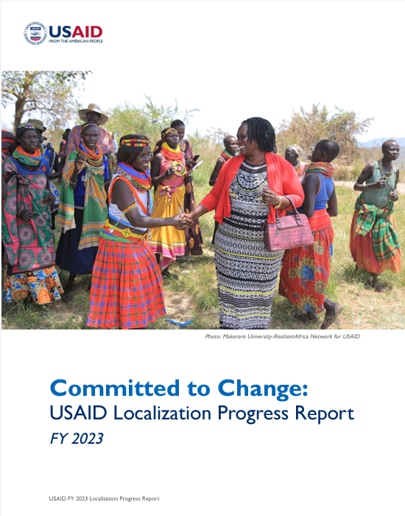
USAID’S TWO AGENCY-WIDE LOCALIZATION GOALS:
25% Direct Local Funding Goal
USAID will provide at least a quarter of all our program funds directly to local partners by the end of FY 2025.
The Agency FY23 Localization Progress report
50% Locally Led Development Development
USAID will take steps to ensure that by 2030, fifty percent of our programming will place local communities in the lead to co-design a project, set priorities, drive implementation, and/or evaluate the impact of our programs.
Notes:
Administrator Power’s vision on DEIA embodies the same principles that are manifested in our localization policies and priorities. Money is power. Shifting 25 percent of our direct funding to local organizations better positions local actors to set their own agendas and develop context-driven solutions. In other words, USAID seeks to diversify our partner base in order to improve inclusion and address inequity in our global health programming. Ensuring 50 percent of our funding includes local voices is about addressing legacy systems of oppression that exclude and disempower the communities that we serve. Localization is a lens through which we accomplish our DEIA priorities.

Slide 12
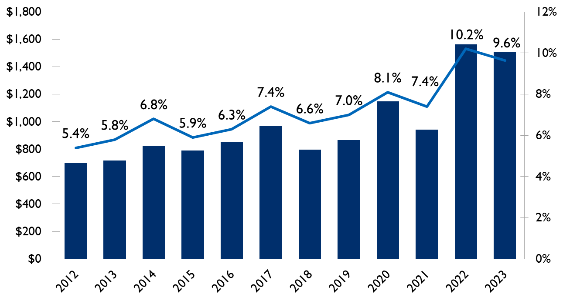
USAID AGENCY WIDE
DIRECT LOCAL FUNDING HISTORICALLY HIGH

Slide 13
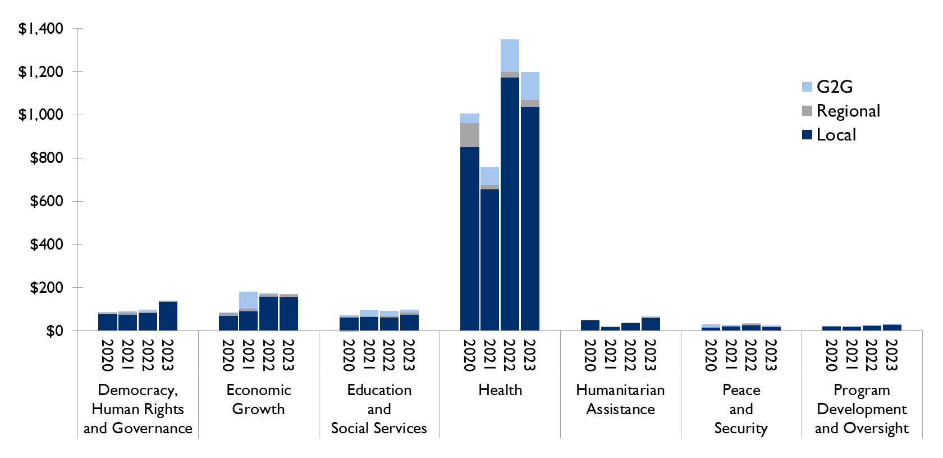
THE HEALTH SECTOR LEADS THE AGENCY IN DIRECT LOCAL FUNDING
USAID FY23 Localization Progress Report

Slide 14
BEYOND DIRECT FUNDING, ELEVATING LOCAL VOICES
USAID Administrator Samantha Power answered questions from local partners in a special Q&A session at the 2021 Local Partner Meeting.
Five local partner representatives asked questions of the Administrator live during the session, which was moderated by Anita Sampson, USAID/South Africa’s Health Office Deputy Director, and attended by 276 local partners and USAID staff members.

Slide 15
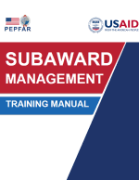
ASAP CONTRIBUTIONS TO LOCAL PARTNER TRANSITION SUCCESS: 2019-2024
ASAP supported 126 local NGO and government partners
ASAP supported 41 local organizations to become new prime partners with USAID
ASAP helped host 5 Local Partner Meetings

Slide 16
ACCELERATING SUPPORT TO ADVANCED LOCAL PARTNERS II (ASAP II)
CLOSEOUT PRESENTATION
Presenter:
Catherine Brokenshire Scott
Project Director
Date: July 18, 2024
Notes:
Note: this session will be recorded

Slide 17
ACKNOWLEDGEMENTS
Sincere thanks to the USAID COR Management Team for supporting us with thoughtful guidance and kindness – Debbie Kaliel, Callie Raulfs-Wang and Courtney Irwin.
Thanks to all the Local Implementing Partners (LIPs) for entrusting us on your path to prime and road to sustainability, we learned so much and shared your successes.
I want to thank the 73 Capacity Advisors who supported 124 local organizations. Thank you for your dedication and partnering with LIPs, you made ASAP I and II successful.
With immense gratitude I want to thank Yonas Asfaw, Deputy Chief of Party who kept all the pieces moving and in full compliance and we provided seamless leadership. Vickie Hayes McGee, Contracts and Grants Manager for timely management of contract requirements and providing country support.
And the entire ASAP II team: Shawn Aldridge, Samrawit Debebe, David Dobrowolski, Nancy Erickson, Corinna Fales, Karin Ganter Luke, Amy Gastinger, Bashir Ghafarzai, Gultineh Kebede, Fikre Keith, Nicholas Matsiko, and Henok Yemen.

Slide 18
ASAP II OVERVIEW
ASAP I
LOP: April 1, 2019, to May 30, 2022
Budget Ceiling: $38,500,000
ASAP II
LOP: May 31, 2022 – October 31, 2024
Budget Ceiling: $16,023,445
PURPOSE
Rapidly prepare Local Partners to have the capabilities and resources to serve as Prime Partners for USAID/PEPFAR programming, in compliance with USAID and PEPFAR procedures, for PEPFAR program implementation.
70% of USAID PEPFAR funding to local prime partners.
Strengthen Local Partners as they transition to receive PEPFAR funding as a USAID Prime Partner to comply with regulations.
Prepare Local Partners to directly manage, implement, and monitor PEPFAR programs, and maintain consistent PEPFAR program achievement and quality.
STRATEGIC
OBJECTIVES

Slide 19
ASAP II CONSORTIUM MEMBERS & WEBSITE
IntraHealth International: USAID/ASAP II Prime Partner
Deloitte: Government-to-Government Support
Foundations for Professional Development Communities of Practice and Training
Right to Care: Strategic Information
SustainAbility Solutions: NUPAS Organizational Assessments and USG Rules & Regulations Support/Training
Visit our website:
https://www.intrahealth.org/asap-resources

Slide 20
ASAP SUPPORTED COUNTRIES
Angola
Cameroon
Côte d’Ivoire
DRC
eSwatini
Ethiopia
Lesotho
Malawi
Namibia
Nigeria
South Sudan
Uganda
Zimbabwe
ASAP I additional countries:
Kenya
Mozambique
South Africa
Tanzania
Zambia
18 COUNTRIES

Slide 21
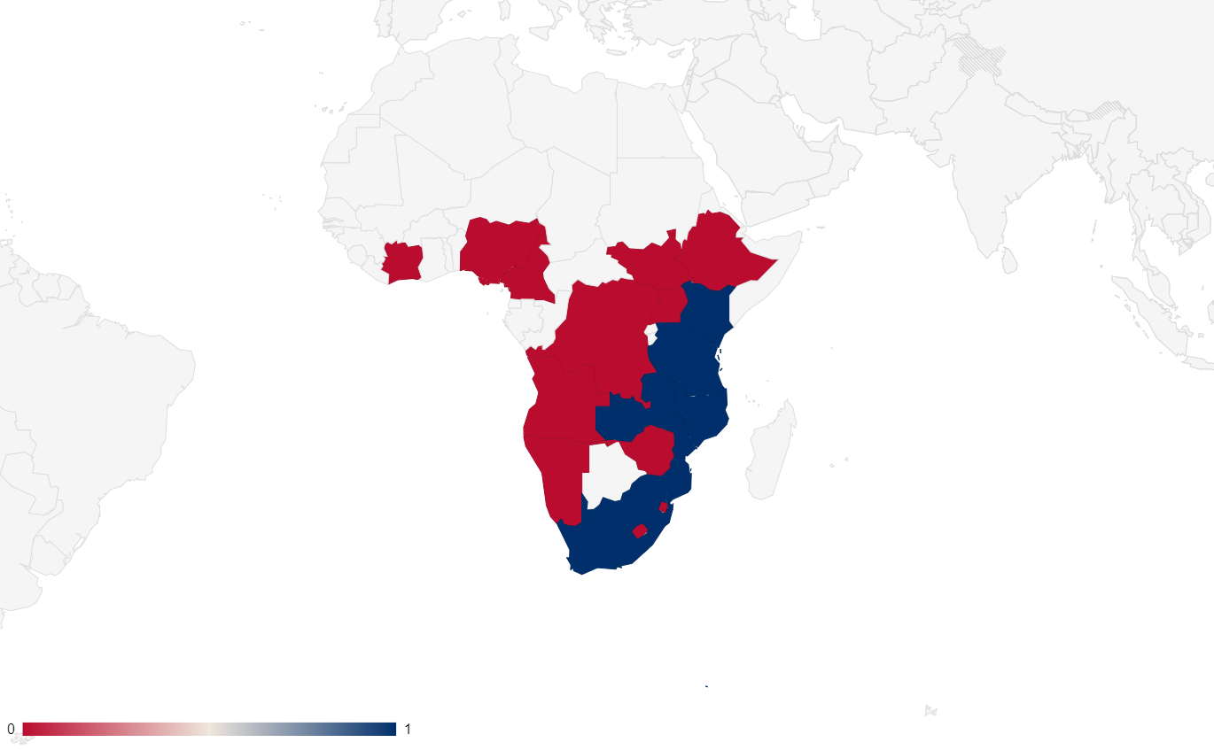
LIPs SUPPORTED
Total ASAP I and II Supported LP | Local Partners | Govt/G2G partners
Supported in ASAP I April 2019 to May 2022 | 63 (26 closed in ASAP I) | 12
Supported in ASAP II May 2022 to July 2024 | 87 (50 new in ASAP II) | 1
LIPs supported | 113 | 13
Total | 126
18 countries supported
41 ASAP-supported organizations have advanced to prime USAID partners.

Slide 22
KEY RESULTS
122 Organizational Assessments
41 Organizations became Prime Partners
73 Local Subject Matter Experts provided continous on-site TA
81 Boards supported
400 Templates for policies and procedures
400 Translations

Slide 23
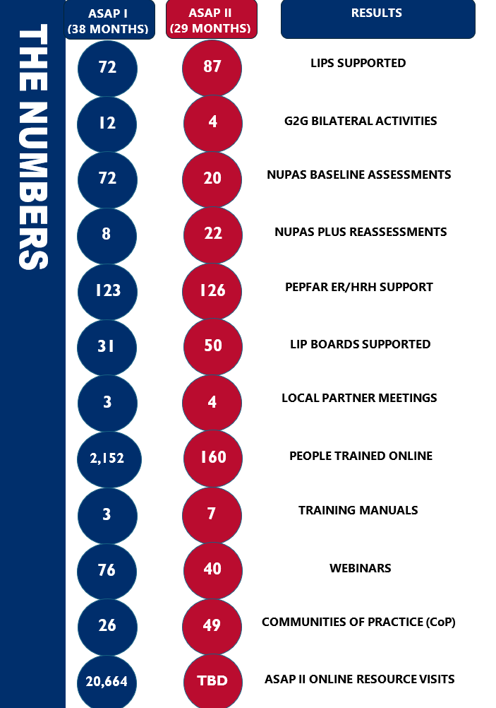
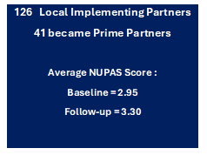
KEY RESULTS

Slide 24
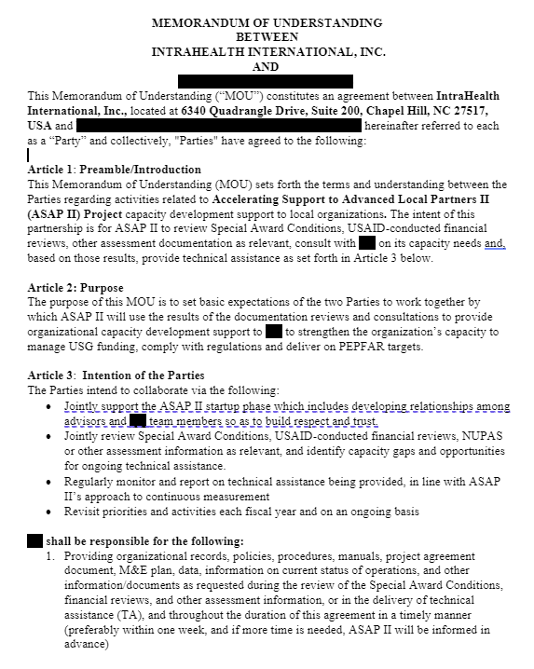
BUILDING TRUST AND COMMITMENT
Local Partner - Responsibilities
Provide all documents requested within the agreed upon timeframe.
Provide office space for assessment and TA
Co-review NUPAS Plus and co-create Capacity Development Plan
Any other matters of importance to LIP
ASAP - Responsibilities
Keep all data confidential, not disclosing any shared or new findings to any persons other than USAID and LIP
Conduct NUPAS Plus in a transparent and educational manner
Co-create Capacity Development Plan
Provide continuous on-site and virtual TA until changes were institutionalize

Slide 25
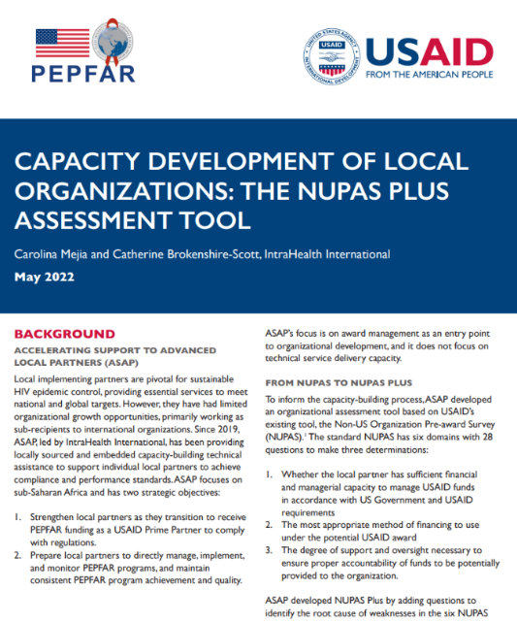
NUPAS PLUS 2.1
Country | NUPAS | NUPAS Plus
Angola | 0 | 8
Cameroon | 0 | 10
Cote d’Ivoire | 0 | 4
DRC | 0 | 9
eSwatini | 0 | 1
Ethiopia | 0 | 18
Kenya | 0 | 1
Lesotho | 0 | 5
Mozambique | 12 | 0
Namibia | 0 | 10
Nigeria | 6 | 9
South Africa | 1 | 0
South Sudan | 1 | 12
Tanzania | 0 | 2
Uganda | 1 | 13
Total | 22 | 102
Score Range | Description
1.00 – 1.50 | Inadequate Capacity
1.51 – 2.50 | Weak Capacity
2.51 – 3.50 | Adequate Capacity
3.51 – 4.00 | Strong Capacity

Slide 26
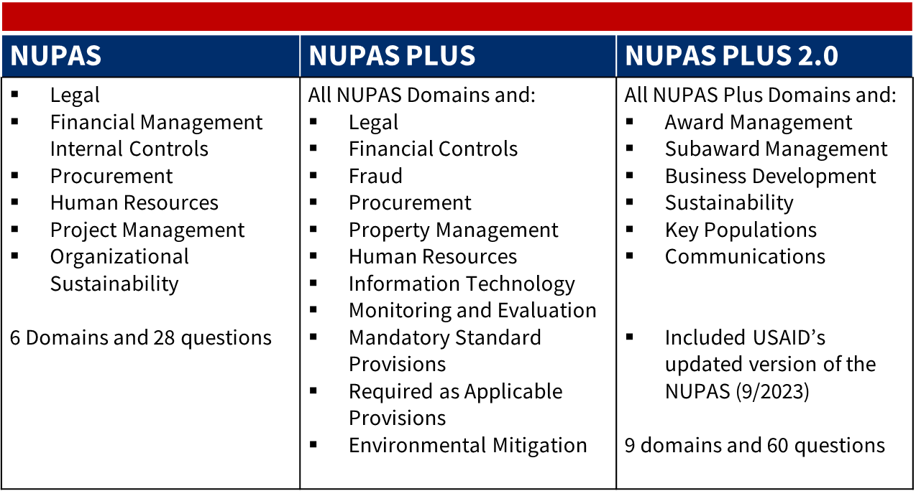
AN ASSESSMENT THAT TELLS THE WHOLE STORY
Non-U.S. Organization Pre-Award Survey (NUPAS)
NUPAS PLUS 2.1

Slide 27
DOMAIN LEVEL CHANGES

Slide 28
HIGHEST RISK AREAS
Risk Management - Risk Assessment
Risk Management - Reporting
Information Technology - Disaster Recovery
Governance - Board Evaluation
Gender - Gender analysis
Business Development - Resource mobilization plan
Information Technology - IT Risk Mitigation
Finance - Cost Allocation
Mandatory Standard Provisions - Debarment and Suspension
Gender - Gender roles and responsibilities
Procurement and Logistics - Terrorism Financing Check
Mandatory Standard Provisions - Conflict of Interest
Information Technology - Cybersecurity
Required As Applicable Provisions - Universal Identifier and System of Award Management

Slide 29
SUSTAINABILITY
Notes:
BACKGROUND
ASAP ’s capacity strengthening support for each local organization began with an initial entry to focus on the USAID funded award mechanism and then quickly moved to focus on the entire organization to use compliance and performance standards to help the organization mature and mobilize increased funding. The NUPAS Plus 2.1 Sustainability Module is a composite indicator with criteria from other domains and provides legal, governance, business development, performance management, finance, human resources, gender and monitoring and evaluation (M&E).
EVIDENCE OF CAPACITY STRENGTHING
Findings of ASAP ’s NUPAS Plus baseline assessments in sustainability revealed that 37% of the partners either lack or have an inadequate and outdated strategic (business) plan, which is not based on SWOT analysis, and not reflective of their current, vision, mission, values, and client priorities. About 40% of partners have no, weak, or rarely complied-with communications and advocacy strategies in place for identifying target audience, channels, and messaging for advocacy and influence, minimal or no capacity for overseeing the quality of communications products, inadequate, unproven or weak analytical capacity for identifying best practices and lessons learned, with minimum to no engagement with external actors on these issues. ASAP also found that almost 30% of partners lacked adequate knowledge management systems, affecting the documenting, storing, and disseminating of program knowledge.
CAPACITY STRENGTHENING ACTIVITES
Activities are listed in the other domains and hence not repeated here.
(Sustainability)
There are sound procedures for responding to changes in leadership, staffing, budgets, government policies, and donor funding levels and priorities, and demonstrated good capacity to identify and adapt to changes in internal and external environments.
LIP has fully responded to most issues identified in the NUPAS and previous capacity assessments, has not experienced setbacks, problems, or delays in response to changes, management consistently assesses staff comfort levels with changes, there is a system for monitoring whether changes are implemented and their positive and negative effects.
There is good proven analytical capacity to identify good practices and lessons learned, strong systems for documenting, storing, and disseminating program knowledge, good practices and lessons learned that are analyzed and shared internally at least twice a year.
LIP has frequently and routinely participated in discussions with donors, governments, and civil society organizations on approaches, lessons learned, and good practices, is plugged into formal networks, and presents its approaches and results at external events.
There is a written strategic plan (business plan), which is regularly updated, is a reflection of LIP’s current vision, mission, and values, and is based on a good analysis of strengths, weaknesses, opportunities, threats, stakeholder needs, realistic resource requirements and availability. In addition, it is reflective of LIP’s priorities, clear and specific priorities, measurable objectives, and targets, and is regularly reviewed and consistently used for management decisions or operational planning.
There is a good two-way communication between management and staff, there are regular structured settings to exchange ideas and discuss problems and opportunities, management consistently listens to staff ideas and seeks staff input, staff frequently initiate discussions with management and raises encountered challenges and there are good communications channels within and across departments or functions.
There is a decision-making process with extensive staff involvement for shared responsibility, ownership, and accountability.
There is a good written strategy for identifying audiences, channels, and materials for external communications, a written external communications strategy that is consistently followed, a good capacity for implementing the external communications strategy, for overseeing written and oral products and a good process for pre-testing and revising external communication messages and materials and monitoring their effectiveness. In addition, there is adequate space and infrastructure to facilitate internal communications.
There are good templates or style guides for documents and website materials, an effective website, and a strongly positive reputation with key stakeholders.
The capacity advisors verified the following criteria, and where a gap was identified they introduced new procedures, system and/or guideline or policy, and facilitate their completion, contextualization, subsequent approval, and execution, and provide contextualized training and/or mentoring as needed on:
Strategic plan in place for three-to-five years
Landscape analysis and donor networking plan developed
Training held on responding to a proposal solicitation including technical proposal, M&E plan, budget, staffing and key personnel, and style guide for the document
Strategy in place for identifying audiences, channels, and materials for external communications; a written external communications strategy is consistently followed
Strategy and strong systems in place for documenting, storing, and disseminating project knowledge and identifying good practices and lessons learned to be included in proposals
ASAP Capacity Advisors provided support to strengthen the organizational policies, procedures, and systems to build the foundation for successful business development. ASAP worked with Boards to develop Strategic Plans which included Resource Mobilization, but the project was careful not to support individual LIP with proposal submissions to USAID or other donors, as this would create an unlevel playing field.

Slide 30
GOVERNANCE
Notes:
BACKGROUND
Board Governance refers to the authority and power bestowed on the board of directors to make decisions on behalf of an organization. “Governance is the systems and processes concerned with ensuring the overall direction, effectiveness, supervision, and accountability of an organization.” Not only does the board have the ultimate authority to act for the organization—it is also accountable for the outcome of any decisions, as well as for the process by which they were made. Board leadership requires a commitment by its members to work together to ensure robust accountability, oversight, and assurance for excellent organizational and financial performance.
For the board to operate effectively they must have Terms of Reference (ToR) which establishes a particular board to oversee and delegate areas of responsibilities. ToRs should include board membership with roles and responsibilities, governing rules, frequency of meetings with proper documentation, decision making authorities, and fiduciary risk management. An active board builds a strong foundation for an organization and indicates to employees, executive teams, and donors that steps are being taken to ensure that compliance processes are in place and being followed.
EVIDENCE OF CAPACITY STRENGTHING
ASAP identified significant capacity deficits among many LIPs within Board Governance —notably: (1) Boards did not conduct evaluations on themselves; (2) lack of governance systems or poorly organized ones; (3) lack of strategic planning; (4) lack of a formal organizational structure and chart; (5) no strategy for financial sustainability; (6) gender imbalances; and (7) inadequate use of technology.
CAPACITY STGRENGTHENING ACTIVITIES
ASAP used a multi-dimensional and holistic focus on LIP sustainability which was hallmark in capacity support in Leadership and Governance.
Self-Evaluations
“ASAP ’s introduction of a collaborative leadership style between the board chairs and executive directors has been embraced and brought successes in the form of improved clarity about the roles and responsibilities, mitigation of risks, increased effectiveness, and accountability about information to be reported to the board and its committees.” Mesmey Ebogo ASAP Leadership & Governance Advisor
Facilitated self-evaluation for board members, reviewed subcommittee structure and conducted individual meetings with each board member to: 1) Set measurable objectives for improving governance that foster enhancement of services that the organization renders, 2) Gather information to assess the effectiveness in improving organizational performance, 3) Draw conclusion based on findings and develop and implement an improvement plan, and 4) Evaluate performance to support sustained. Board Charter
Ensured there was a board charter that includes: board appointment and constitution, board processes, board tenure, board functions, board committees, roles of CEO, chairperson and board members, approved board organogram,
Changed board compositions by building on the existing strengths of each LIP and made them “fit for purpose.” To this end, we developed a simple but effective tool called a Board Skills Matrix, which prompted productive discussion on Board makeup. Governance and Executive teams used the tool to map their Boards’ strengths and weaknesses by identifying the skills, experience, knowledge, and capabilities that members should have, and to understand how to better constitute them to align with their strategic objectives.
Change Management
Ensured change management policies and procedures included processes or structures for responding to changes in leadership, staffing, budgets, government policies, and donor funding levels and priorities.
Coached Board Chairs to elevate the professionalism of boards ensuring that (1) Board members and officers were elected for a specified time period; (2) Scheduled the minimum number of meetings, sets agenda, leads discussions, arrives at decisions, and documents the meeting and (3) Fiduciary risks and programmatic performance are consistently reviewed
Conducted a diversity and gender analysis and provided training as diverse Boards perform better when they include people who come from a range of perspectives, life experiences, and backgrounds. Not only did the gender balance change—we have reports of women assuming Board chair and other member roles and actively participating in Board meetings and organizational activities. There has been a clear move toward having diverse Boards with a balanced gender mix.
Focused on long term sustainability and growth by supporting strategic planning sessions to refresh the LIPs vision, mission, and goals, and to set a roadmap for future stability by diversifying funding sources.
Community of Practice
Created a Community on Leadership and Governance which gives LIP Board Members and Management a platform for regular collaboration and information sharing, improving their skills, and actively working to advance general knowledge of Governance and Leadership.
“Defining Governance,” NCVO, accessed May 26, 2022, https://beta.ncvo.org.uk/help-and-guidance/governance/what-is-governance/explaining-governance/#defining-governance

Slide 31
MONITORING & EVALUATION
Notes:
BACKGROUND
Strategic information is a key element of the U.S. Government’s PEPFAR/USAID programming. Planning, monitoring, and implementing successful programs to combat HIV/AIDS depends on sound data gathering, analysis, presentation, and reporting. As part of its support for monitoring, evaluation, and reporting (MER) guidance, PEPFAR provides a set of essential indicators for program management. These indicators reflect internationally accepted measures and collectively measure the holistic well-being of individuals and their families receiving PEPFAR support. The indicators track the way PEPFAR program participants gain from and contribute to the broader developmental support of the United States Government (USG) to developing countries globally and in the African region. These indicators are designed as “required/reported indicators” meaning that PEPFAR requires organizations to collect data on these indicators periodically (weekly, monthly, quarterly, semi-annually, and annually). The data generated supports improved, evidence-informed strategic program development, implementation,
resource allocation, monitoring and evaluation, and decision-making at all levels of program management.
CAPACITY STRENGTHENING ACTIVITES
Policies and Plans
Supported the development of Activity Monitoring, Evaluation and Learning Plans (AMELP) for PEPFAR and other USAID funding streams.
AMELP’s included PEPFAR reporting requirements, including DATIM data reporting, MER, and Site Improvement through Monitoring Systems (SIMS), and submit timely, high quality reports that capture lessons learned
Supported the development of Collaborating, Learning and Adapting (CLA) plans as part of the AMELP.
Ensured processes and procedures supported project life cycle, by developing goals, SMART objectives, workplans with activity descriptions, budget, indicators, and targets.
Ensured policies, procedures and tools for data quality audits are available and used, data quality audits are conducted as per stipulated procedures, findings and feedback from the data quality audit are shared with stakeholders.
Ensured AMELP included Performance Indicator Reference Sheets (PIRS), including indicator definitions, methodology, transparency in decision-making around indicator selection and indicator changes, and collaboration between USAID and partners to collect high-quality data.
Ensured the plan included a data analysis plan that shows project performance and facilitates planning for corrective actions, performance improvement, and scale up of successful interventions.
Staffing
Supported the development of an M&E unit with an adequate number of permanent positions and all M&E unit staff have qualifications and experience specific to M&E.
Training
Conducted training to carry out tasks relating to assessment of data quality (completeness, timeliness, accuracy, reliability) with no gaps.
Ensured LIP leverage existing training resources to enhance sustainability and cost effectiveness by partnering with ministry of health (MOH) and other stakeholders.
Ensured all staff were familiar with data quality standards and how they applied to indicators and data.
Data Collection Tools
Ensured there were essential tools and equipment for data management which were consistently available, all tiers of data collection and reporting used standardized data collection forms, there were tools used to capture essential indicators, LIP has consistently identified gaps in the existing tools that need to be updated and there are M&E guidelines to document the procedures for recording, collecting, collating, and reporting routine data from the health information system.
Developed a database for capturing and storing PEPFAR data is up to date, it consistently captures all data elements required by the LIP M&E system and the LIP can generate routine monitoring reports using its databases.
Developed tools for supportive supervision are available, and the last supportive supervision was conducted in accordance with the current guidelines.
Data Use
Ensured there was a process for using data for decision-making, through data use plan that compares actuals to targets, performs trend analysis, reviews how such analysis can be used to steer progress, looks for patterns and maps data to identify HIV “hotspots” and underserved locations for the purposes of program improvements.
Developed interactive data visualization and analytics tools, leveraging standardized data collection and innovative data aggregation techniques that are easier to use, and produce faster, better insights for all PEPFAR stakeholders.
Reporting
Supported the LIP to prepare technical/progress reports for the donor that are complete, reliable and on time.
Supported the annual reporting of Expenditure Analysis and Human Resource for Health.
LIP are familiar with the process of submitting a COP and award-required annual workplans and budgets, can complete a high quality COP for their planned award, and have allocated realistic timeframes to prepare these COP for their planned award, and subsequent iterations for final approval.
OBSERVATIONS FROM THE FIELD
Through their close work with LIPs, ASAP ’s Capacity Advisors have seen a pattern of volunteers being used for data collection at many organizations in Cameroon and DRC. Although community-based volunteers can save money and play a role in reaching remote community members and key populations, this practice raises concerns regarding data security and organizational sustainability. Relying on volunteers rather than paid staff may artificially reduce project costs (as compared to those implementing with full-time, paid staff) and deserves more study to ensure that project budgets can be sustained when an organization becomes a USAID prime partner, and that staff are formally hired and fairly paid for their contributions.
An additional consideration in the use of volunteers for data collection are the inherent privacy and security concerns when obtaining and storing community health information. Volunteers are often not as well vetted or trained as an organization’s paid staff and do not necessarily have access to the same systems and technology to collect, secure, and transmit data. The organization also risks a high turnover rate for unpaid volunteers and loses some institutional knowledge when project staff do not take part in data collection.
M&E staff turnover can affect an organization’s ability to successfully implement projects, particularly when replacements are less qualified or experienced in the organization’s systems and practices. The ASAP Salary Survey found that LIP tend to pay staff well below what international organizations can offer, resulting in the high turnover rate of M&E staff that many LIPs experience. M&E staff often start working with LIPs, but once a position with an international NGO becomes available, they move. It is important to note that M&E staff at LIP are often project-specific and not permanent employees of the organization, due to a lack of reliable funding for such positions. It is therefore important that management at LIPs prioritize M&E during resource mobilization to support organizational growth and sustainability.
As USAID continues to pivot toward LIPs, ensuring the quality of data collection, storage, and analysis are key priorities. During the past three years, ASAP has recognized a trend to undertake data quality assurance (DQA) at the prime level, without subrecipient participation. The risk of this practice is that subs will not have an opportunity to observe the process and build their own skills around DQA. Institutional knowledge on DQA will remain with the prime rather than cascading to the subrecipients, which may result in organizations becoming prime partners without the capacity to conduct DQA. Providing capacity-building support and mentoring on DQA for subs is especially difficult when they are not given an opportunity to work with the primary data, as it is often sent directly to the prime without additional participation by the sub.
Additionally, data storage, security, and internet connectivity continue to be a struggle for LIPs and should be a primary concern for USAID, particularly for global health projects where sensitive patient data is collected. With USAID’s focus on transitioning to digital solutions, it is important to consider the reality of the local context and limitations on the ground. Forcing the use of digital processes when the system does not function in day-to-day operations does not account for the realities of the local context or aid in implementing projects. In some cases, paper-based data collection is the most practical approach, especially in remote areas or those with limited access to consistent internet connectivity, and this practice should be accommodated in those instances.
Although all LIPs recognize the importance of storing and securing data, local context can affect their access to the technology required for proper handling of data. In ASAP ’s experience, some LIPs do not have organizational email or secure servers and data back-up processes, often lacking the staff or skillset to set up or maintain these systems. Support in the IT domain should play a crucial role in any future capacity-building projects, but each organization must be assessed individually, with the local context in mind. Imposing technology and regulations in areas where access to these skillsets—and sometimes the prohibitive cost of installing or maintaining these systems—must be addressed to improve compliance and sustain the use of these systems, even after donor funding ceases.
Additionally, data collection in remote locations, or for organizations with inconsistent access to the internet, often requires paper-based systems. In some cases, the data travels long distances to headquarters to be turned into digital documents. Additionally, advisors have noted that LIPs often struggle with the process of converting paper-based data into a digital format, which results sometimes in inaccurate data or data loss with the potential to misrepresent program activities in the field.

Slide 32
LEGACY RESOURCES

Slide 33
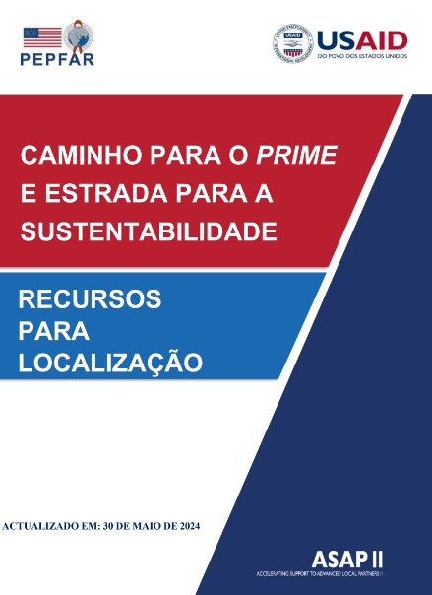
ONE STOP SHOP TO BECOME A USAID PARTNER
Templates translated to:
French
Portuguese
Swahili
OPEN THE MANUAL
NOT YET PUBLISHED
NOT YET PUBLISHED

Slide 34
PATH TO PRIME AND ROAD TO SUSTAINABILITY
TABLE OF CONTENTS
THE PRESIDENTS FUND FOR AIDS RELIEF (PEPFAR)
USAID
WorkingwithUSAID.gov
USAID Localization
Understanding USAID Policies and Procedures
Register to Work with USAID
Understanding USAID Award Types
Understanding Required Compliance Provisions
USAID Implementation Policy Documents
USAID Proposal Writing
PRE-AWARD SURVEYS FOR NON-US ORGANIZATIONS
CAPACITY DEVELOPMENT PLAN
NGO GOVERNANCE AND LEADERSHIP
FINANCIAL MANAGEMENT AND COMPLIANCE
RISK MANAGEMENT
PROCUREMENT AND LOGISTICS
PROPERTY MANAGEMENT
INFORMATION TECHNOLOGY
SUBAWARD MANAGEMENT
HUMAN RESOURCES
GENDER
14. NGO GOVERNANCE AND LEADERSHIP
15. FINANCIAL MANAGEMENT AND COMPLIANCE
16. RISK MANAGEMENT
17. COMMUNICATIONS
18. MONITORING AND EVALUATION
19. ENVIRONMENTAL MITIGATION AND MANAGEMENT
20. WEBINARS
21. COMMUNITIES OF PRACTICE
Each Topic Includes:
Policies
Training Material
Webinars
Resources
Templates
Capacity Standards

Slide 35
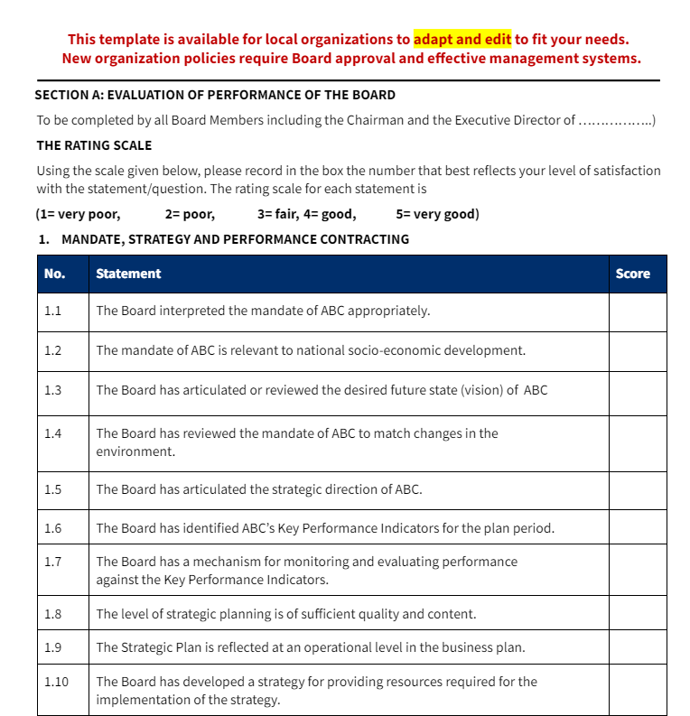
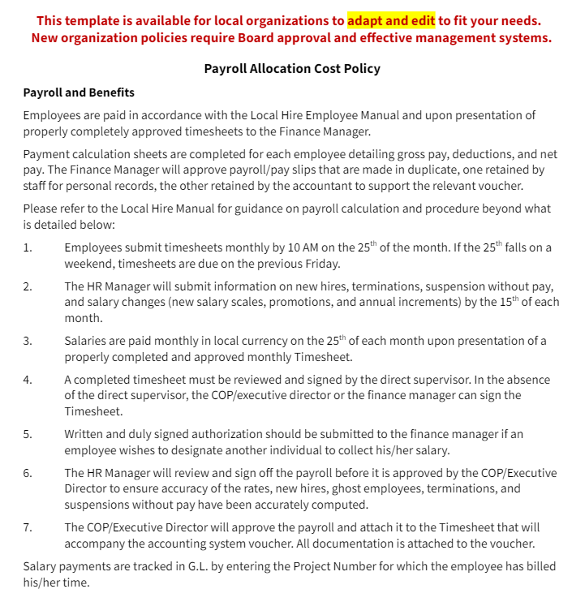
ORGANIZATIONAL TEMPLATES
Templates translated to:
French
Portuguese
Swahili

Slide 36
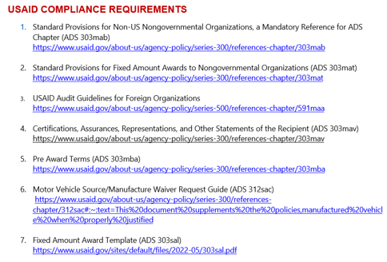
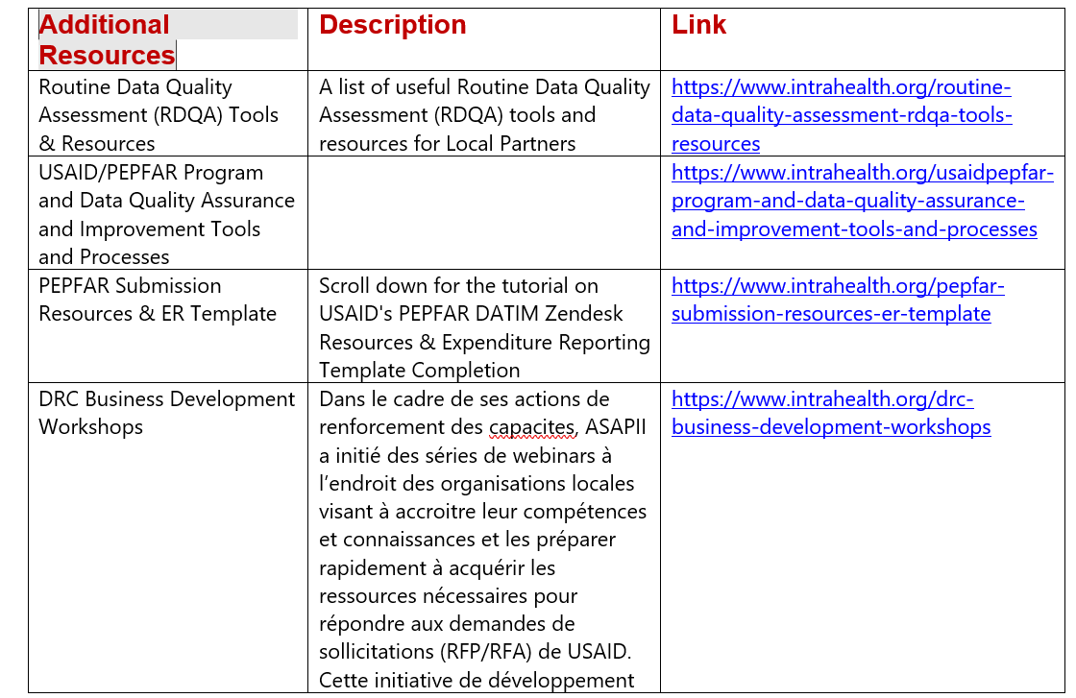
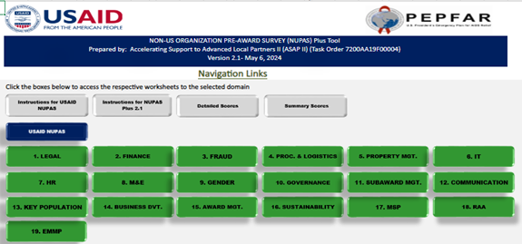
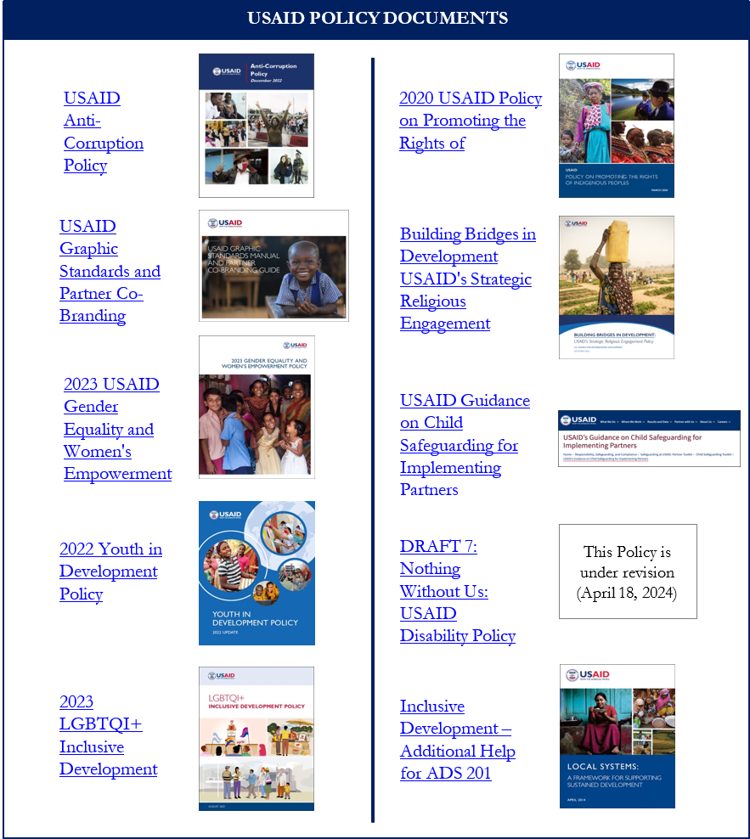
PATH TO PRIME AND ROAD TO SUSTAINABILITY
Organizational Templates
42 Legal
35 Finance and Compliance
34 Human Resources
20 Monitoring and Evaluation
16 Gender
15 Information Technology
12 Procurement
6 Gender

Slide 37
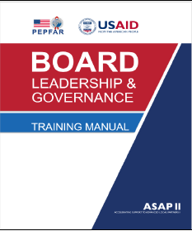
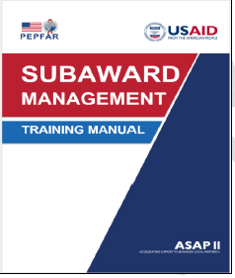
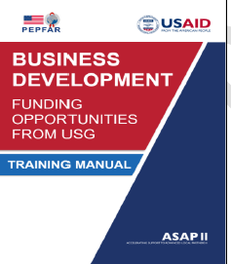
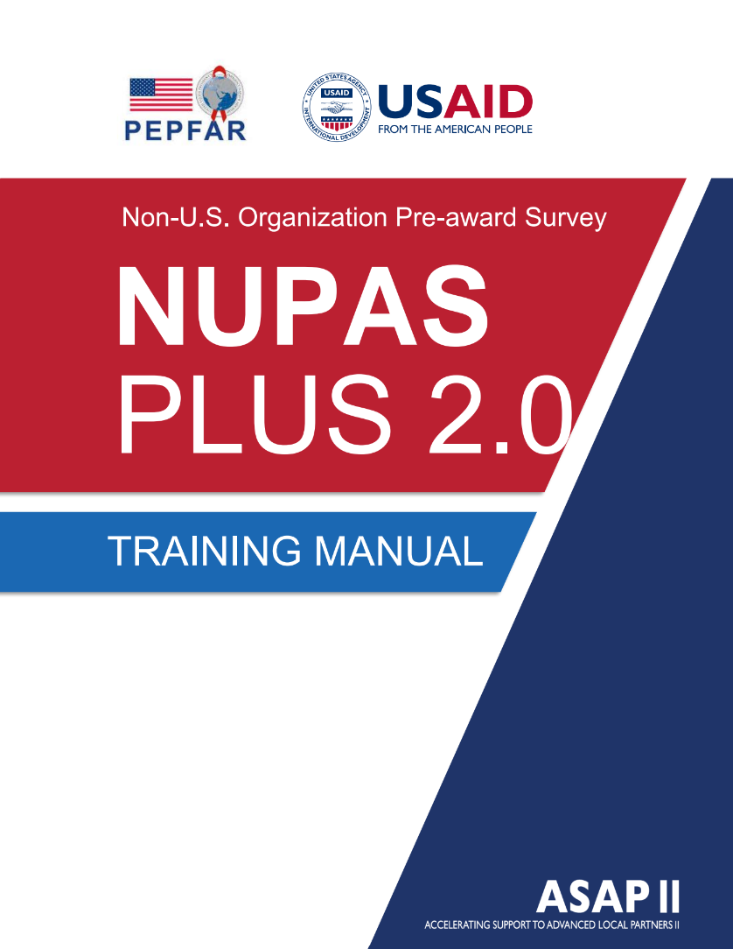
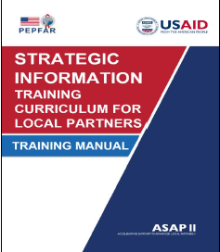
TRANSLATED TRAINING MANUALS
OPEN THE MANUAL
OPEN THE MANUAL
OPEN THE MANUAL
OPEN THE MANUAL
NOT YET PUBLISHED

Slide 38
GLOBAL ACTIVITIES
Responsive and evolving USAID Local Partner Meetings
Webinars in multiple languages
Community of Practices in multiple languages and different organizational development topics
Virtual Training

Slide 39
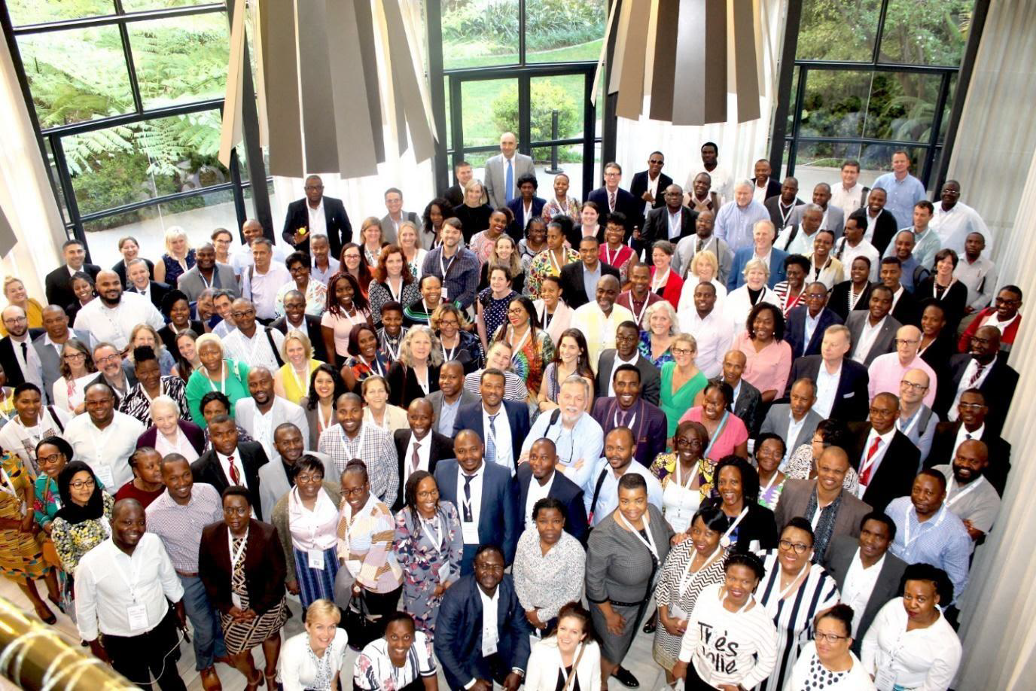
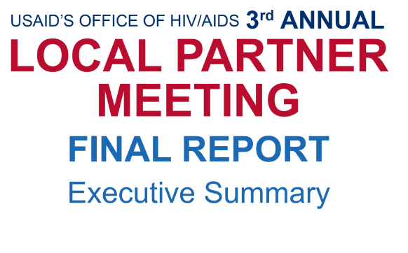
ANNUAL REGIONAL LOCAL PARTNER MEETINGS
1st Meeting
2nd Meeting
3rd Meeting
4th Meeting
Nov 4-8, 2019
Johannesburg, SA
273 Participants
Oct 6-9, 2020, Virtual
882 Participants
Nov 1-5, 2021, Virtual
Nearly 1000 Participants
Nov 14-17, 2022, Johanesburg, SA
500 in-person, 270 virtual

Slide 40
5TH ANNUAL REGIONAL LOCAL PARTNER MEETING
Nov 6-9, 2023, Accra, Ghana
550 in-persons and 293 virutal

Slide 41
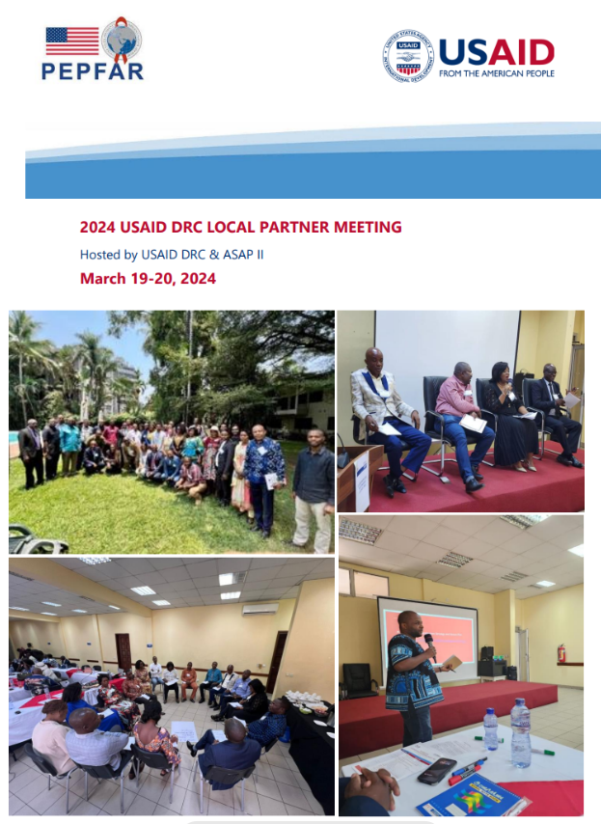
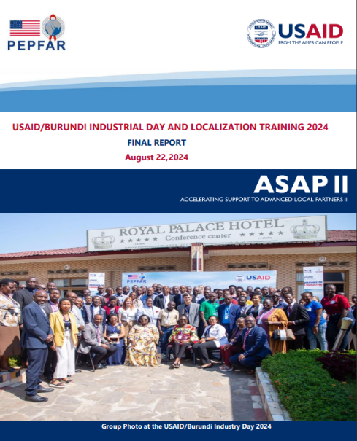
COUNTRY LOCAL PARTNER MEETINGS

Slide 42
VOICES FROM THE FIELD (1)
WHAT IS WORKING WELL WITH USAID PARTNERSHIP
Responsive communication with AOR with supportive guidance
Orientation/inception meeting at the beginning of the project to cover roles and responsibilities, communication lines, and where to find information
Monitoring Visits
Standardized data collection and management tools

Slide 43
VOICES FROM THE FIELD (2)
CHALLENGES
Language barrier as English is not local language
Indirect Costs and Understanding USAID Award and Compliance Requirements
Local Partner Meetings are needed at the country level
M&E systems need to be upgraded to electronic from paper-based
Salary gap between INGOs and local partners, which affects recruitment and retention
Sustainability at the end of the project
ASAP RESPONSE
Translated 30 + USAID documents into 7 languages
Conducted 116 webinars to date for 28,338 attendees, hired 73 embedded capacity advisors, developed 212 templates for policies and tools
Conducted LP meetings in Burundi and DRC
Upgraded data collection to online and at point-of-service
Conducted Market Salary Survey to document gap and revised salary bands for local organizations and included competitive salaries in budgets
Developed/translated Business Development Training Manual, conducted training and webinars; and developed/translated Leadership and Governance Training Manual to upgrade effective Board management for sustainability

Slide 44
COMMUNITY OF PRACTICE IN ASAP II
Portuguese: 6
CoP Benefits: Feedback from Participants
Good networking opportunities
Helps to solve project challenges by sharing practical experiences on running projects
Brings learning and sharing of best and efficient practices
Highlighting strategies to manage performance and tactics to measure outcomes
Helps foster a feeling of being a part of a community and not alone in dealing with project challenges
Safe space to raise issues and challenges, ask questions, and get guidance
MONITORING & EVALUATION
English: 5
French: 9
LEADERSHIP & GOVERNANCE
English: 6
Portuguese: 1
Portuguese: 6
FINANCE & COMPLIANCE
French: 15
English: 1
TOTAL COP SESSIONS: 49
TOTAL PARTICIPANTS: 2004

Slide 45
TRANSLATIONS
into
Seven Languages

Slide 46
PATH TO PRIME & ROAD TO SUSTAINABILITY The Story of Integrated Service on Health and Development Organization (ISCHDO) Ethiopia OPEN VIDEO

Slide 47
CAPACITY STRENGTHENING SUPPORT THROUGH ASSESSMENTS & FINANCIAL MANAGEMENT– MY EXPERIENCE

Slide 48
OUTLINE
NUPAS Plus 2.1
Assessments Findings – Financial Management
Capacity Development Plan (CDP)
ASAP II Technical Assistance in Financial Management
Success Stories
Lessons Learnt/Recommendations

Slide 49
NUPAS PLUS 2.1 DOMAINS
9

Slide 50
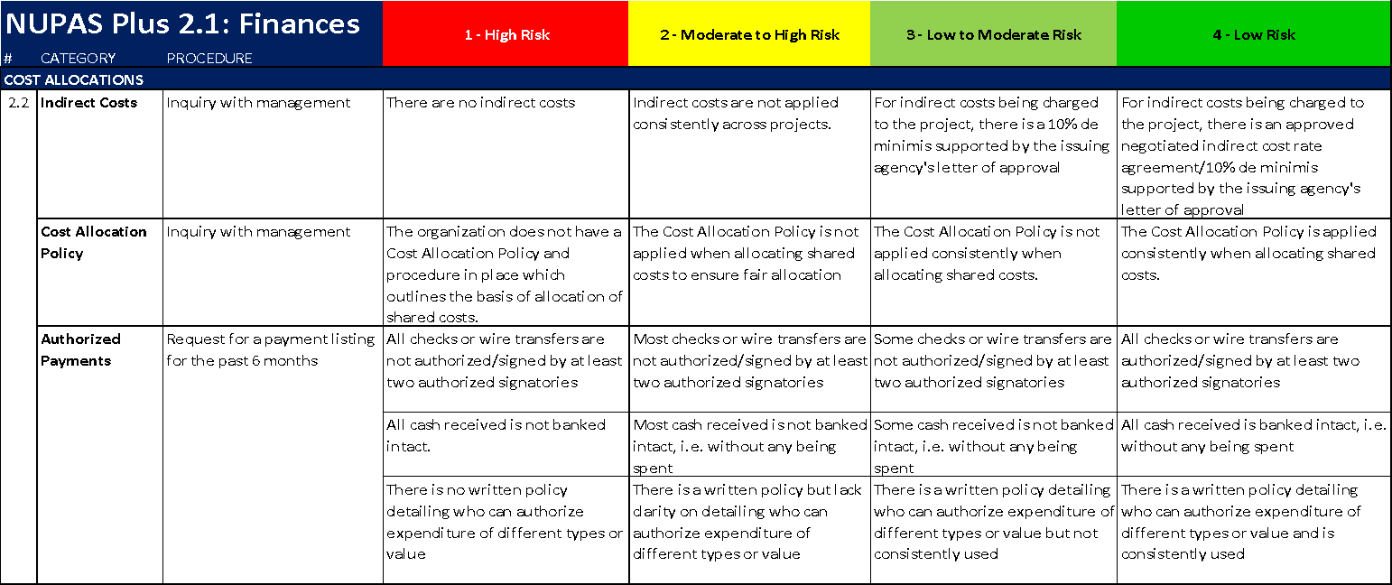
NUPAS PLUS 2.1 DOMAIN RISK ASSESSMENT SAMPLE CRITERIA

Slide 51
ASSESSMENT FINDINGS – FINANCIAL MANAGEMENT
Manual Internal Audit Systems
No backup system
Weak Fraud Policy
Low staff knowledge on accounting systems
Weak Accounting System
Inadequate Segregation of Duties
Poor Budget Quality
Absence of Risk Management
Incomplete Procurement policy
Unregistered CSOs
Lack of indirect cost policy
Tax non-compliance
Gaps in Financial Reporting
Weak Subaward Management

Slide 52
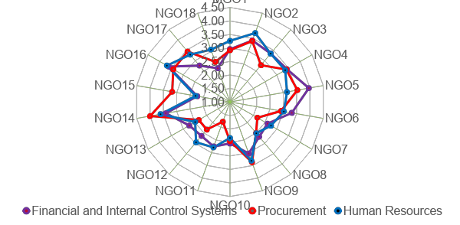
EACH ORGANISATION IS UNIQUE

Slide 53
FINANCE
Notes:
At baseline significant capacity deficits included:
Boards did not conduct evaluations on themselves
Lack of governance systems or poorly organized ones
Lack of strategic planning
Lack of a formal organizational structure and chart
No strategy for financial sustainability
Gender imbalances;
Inadequate use of technology
BACKGROUND
USAID’s rules and regulations for financial management are explicitly stated in Mandatory Standard Provisions and the Required as Applicable Provisions for Non-U.S. NGOs and cover:
Accounting
Allowable Costs
Audits
Budgets
Conflict Of Interest
Cost Sharing
Employee Whistleblower Protections
Mandatory Disclosures
Negotiated Indirect Cost Rates
Never contract with the enemy
Not working with Sanctioned Groups and Individuals
Program Income
Reporting Host Country Taxes
In order to meet the requirements, LIP must have internal policies and procedures which are compliant and be fully institutionalized. We ensured that our capacity support focused on the requirements of the award but also and deliberately were applied to the entire organization to support sustainability and growth.
Financial Management was a priority area for all LIP. ASAP hired X expert Capacity Advisors to provide on-site embedded technical assistance.
EVIDENCE OF CAPACITY STRENGTHING
The factors identified as primary causes for the high-risk areas were: (1) staff lacking the skills, knowledge, and ability to ensure compliance with underlying documents; (2) organizational culture resistant to change; (3) constitution, statutes, internal rules, and regulations that were either not in place or not aligned with compliance; and (4) management teams’ lack of independence from Boards of Directors.
Some of the greatest challenges that LIP face in working with donors such as USAID relate to the timing and conditions of financial support—specifically that: (1) LIP often lack the funds to prefinance activities, which is a common practice for international NGOs; (2) late disbursement of funds for contracts, cost reimbursement, and fixed amount awards can require prefinancing of project activities, sometimes through loans; (3) indirect cost allocation is lacking for sub grantees to LIP; and (4) staff salaries are often very low, as compared to international organizations, and are often paid irregularly.
CAPACITY STRENGTHENING ACTIVITIES
In response to the findings of the NUPAS assessment for each organization, ASAP provided financial management and compliance support/solutions tailored and adapted to address specific capacity gaps. Capacity Advisors provided support to develop new policies and procedures and provided experiential learning opportunities, training, mentoring, and job aids on the following:
Accounting
Ensured LIP had an effective system in place to track sources of funding.
Revised the Chart of Accounts to include a list of financial accounts, reference numbers, grouped into categories such as assets, liabilities, equity, income, and expenses and used to record transactions in the General Ledger.
Supported the procurement of on-line accounting software such as Sage, QuickBooks and provided training.
Confirmed financial statements were regularly and consistently derived from the general ledger (trial balance), and financial statements were prepared in accordance with applicable national and international accounting standards
Institutionalized best practices for petty cash including a physical petty cash count is made on a regular basis (weekly/monthly) and checked by a senior staff member and documented, petty cash reconciliation is done at least every month, all disbursements made within the predetermined maximum amount for petty cash disbursements, and supporting documentation for disbursements contain the description of disbursement and show the date of disbursement.
Ensured there are bank account(s) in a registered commercial banking institution appropriate for the LIP mission and/or goals, that are accurately reconciled on a monthly basis with documentation to show the dates, who prepared, reviewed and approved them, with corresponding signatures affixed.
Checked bank transfers were signed by at least two authorized signatories, that all cash received was banked intact,
Supported the development of Delegation of Authority (DoA) identifying thresholds for approvals at the various levels of the organization.
Developed procedures to check expense claims for staff advances against the amount advance and reconciled, there is proper documentation demonstrating advances were received by the appropriate staff.
Verified finance staff had the requisite level of knowledge, skills, and experience in this area to effectively manage donor funds.
Developed systems to manage fluctuations in an exchange rate, including how to use a weighted average exchange rate.
Allowable Costs, Cost Allocation and Cost Sharing
Provided training on allowable costs to meet the criteria of reasonableness, allocability and compliance with USAID’s rules and regulations.
Developed cost allocation policies which outlined the basis of allocation of shared costs and includes an approved negotiated indirect cost rate agreement/10% de minimis, supported by the issuing agency's letter of approval. If it exists, the advisor confirms if it is applied consistently when allocating shared costs
Ensured appropriate systems tracked unallowable costs.
Audits
Reviewed previous financial and audit reports, including disallowed or questioned costs and management responses, to give ASAP a holistic view of the organization, understand progress made to date, and ensure plans address pre-identified gaps and confirms if findings and past performance issues are reflected in transition plans.
Ensured there were appropriate policies, procedures, and practices in place, for managing and closing audit findings and recommendations.
Helped organizations prepare for their first or next audit.
Budgets
Supported the development of an annual budget and verified that: (1) finance and program staff were involved in preparing the budget, project activities are based on costs of planned activities; (2) budgets included budget notes and clear calculations, separate budgets are prepared for each donor and project, organizational annual budgets are reviewed and approved by the board of trustees, a named individual (budget manager) is responsible for implementing and managing each budget, and all planned operational costs are adequately funded.
Ensured financial reports were accompanied by budget data and variance analysis (budget to actual cost) reports and that program managers consistently review financial reports and take corrective action.
Conflict of Interest (COI)
Developed policies and procedures to declare conflict of interest for all Board members and staff.
Supported institutionalizing an annual CoI process.
Mandatory Disclosures
Supported LIP to correctly disclose and report to the Office of the Inspector General and the AOR/COR any violations involving fraud, bribery, or gratuity violations affecting the award.
Reporting
Ensured LIP consistently and accurately produced reliable monthly financial statements from the general ledger in accordance with its written procedures, financial statements were reviewed by organization’s management and corrective actions are taken when necessary.
Supported processes to complete USAID Financial Reports and PEPFAR expenditure analysis reports and to upload into Data for Accountability, Transparency, and Impact Monitoring.
Organizational Templates
In the Path to Prime and Road to Sustainability Document, ASAP created and translated templates for organizational policies and procedures.

Slide 54
CAPACITY DEVELOPMENT PLAN (CDP)
Based on assessment scores
Collaboratively determine activities for the CDP
CDP includes;
Key activities
Deliverables
Person responsible
Timeframe
Reassessment date
The Local Implementing Partner (LIP) must agree to and own the actions in the CDP.

Slide 55
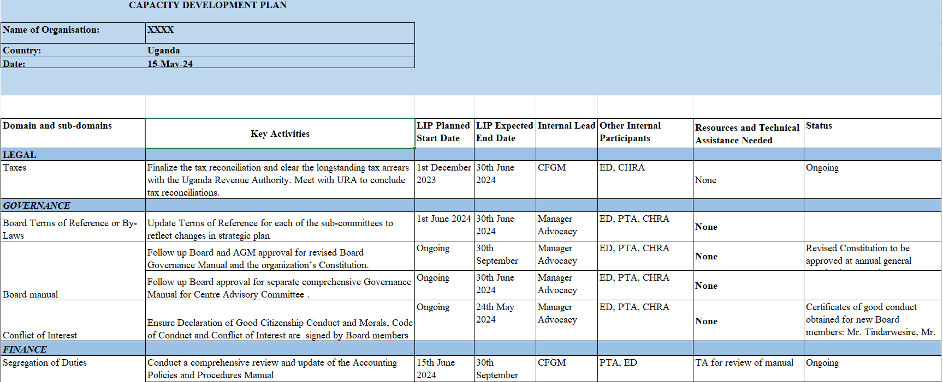
CAPACITY DEVELOPMENT PLAN SAMPLE

Slide 56
ASAP II TECHNICAL ASSISTANCE IN UGANDA
Reviewed operational policies and procedures, including Finance, Procurement, Risk Management, and Internal Audit across both HIV and OVC LIPs, as applicable.
Supported the configuration and customization of accounting systems for OVC LIPs transitioning from QuickBooks desktop to the online version.
Conducted multiple trainings for the LIPs including but not limited to Fraud Awareness and Prevention, Risk Management, and Procurement.
Assisted LIPs in understanding NGO registration requirements, including the necessary letters of recommendation at different levels and how to complete the required forms.
Mentored LIPs Finance Directors on compliance matters and other financial management matters, such as audit requirements for USAID project audits and cost share documentation and reporting.

Slide 57
SUCCESS STORIES
Assessments of 6 HIV partners using a blended NUPAS Plus and OCA tool, and NUPAS Plus 2.0 sustainability tab, and co-created the respective Capacity Development Plans (CDP)
Functional accounting systems at all OVC LIPs
Rolled out a fraud risk assessment tool
Boards approved revised operational policies and procedures manuals, and related tools
Completed a new strategic plan through a participative process that involved all key stakeholders, including the Board, senior management, and staff.
Developed comprehensive risk registers.
Utilized ASAP II training webinars to cascade training to their partner organizations.

Slide 58
EVIDENCE BASED CAPACITY STRENGTHENING
Ethiopia NUPAS Plus Consensus
Building and Review of Progress

Slide 59
LESSONS LEARNT/RECOMMENDATIONS
Each organization has unique challenges, making assessments essential to tailor capacity-building efforts.
Even in high-scoring domains, there are high-risk areas that require strengthening to ensure overall organizational health and effectiveness.
Organizations often recognize their gaps but lack the resources to address them.
Adapting the approach of NUPAS Plus 2.1 to include self-assessments as well as external assessors leads to stronger ownership of the results and the CDP.
For non-English speakers it was important to translate the assessment tool and the CPD into their own language.
USAID needs to find resources to procure elements in the CDP, such as online accounting software or the recommended staff positions needed.
Primes can use the NUPAS Plus 2.1 with subs and should be included in budgets.

Slide 60
ORGANIZATIONAL STRENGTHENING FOR BOARD SUSTAINABILITY
Presenter:
Petronella Mwasandube, ASAP II Senior Capacity Advisor Governance and Leadership
Date: July 18, 2024

Slide 61
AGENDA
To share the ASAP II approach to strengthening board governance for each local partner.
How we created a safe space for each organization to positively embrace the importance of governance.
Strategies used for each LP to reflect on their practices.
Importance of securing buy-in and working collaboration to instill good board governance.
Share personal and collective actions and tools used to strengthen each board.

Slide 62
GOVERNANCE
Notes:
BACKGROUND
Board Governance refers to the authority and power bestowed on the board of directors to make decisions on behalf of an organization. “Governance is the systems and processes concerned with ensuring the overall direction, effectiveness, supervision, and accountability of an organization.” Not only does the board have the ultimate authority to act for the organization—it is also accountable for the outcome of any decisions, as well as for the process by which they were made. Board leadership requires a commitment by its members to work together to ensure robust accountability, oversight, and assurance for excellent organizational and financial performance.
For the board to operate effectively they must have Terms of Reference (ToR) which establishes a particular board to oversee and delegate areas of responsibilities. ToRs should include board membership with roles and responsibilities, governing rules, frequency of meetings with proper documentation, decision making authorities, and fiduciary risk management. An active board builds a strong foundation for an organization and indicates to employees, executive teams, and donors that steps are being taken to ensure that compliance processes are in place and being followed.
EVIDENCE OF CAPACITY STRENGTHING
ASAP identified significant capacity deficits among many LIPs within Board Governance —notably: (1) Boards did not conduct evaluations on themselves; (2) lack of governance systems or poorly organized ones; (3) lack of strategic planning; (4) lack of a formal organizational structure and chart; (5) no strategy for financial sustainability; (6) gender imbalances; and (7) inadequate use of technology.
CAPACITY STGRENGTHENING ACTIVITIES
ASAP used a multi-dimensional and holistic focus on LIP sustainability which was hallmark in capacity support in Leadership and Governance.
Self-Evaluations
“ASAP ’s introduction of a collaborative leadership style between the board chairs and executive directors has been embraced and brought successes in the form of improved clarity about the roles and responsibilities, mitigation of risks, increased effectiveness, and accountability about information to be reported to the board and its committees.” Mesmey Ebogo ASAP Leadership & Governance Advisor
Facilitated self-evaluation for board members, reviewed subcommittee structure and conducted individual meetings with each board member to: 1) Set measurable objectives for improving governance that foster enhancement of services that the organization renders, 2) Gather information to assess the effectiveness in improving organizational performance, 3) Draw conclusion based on findings and develop and implement an improvement plan, and 4) Evaluate performance to support sustained. Board Charter
Ensured there was a board charter that includes: board appointment and constitution, board processes, board tenure, board functions, board committees, roles of CEO, chairperson and board members, approved board organogram,
Changed board compositions by building on the existing strengths of each LIP and made them “fit for purpose.” To this end, we developed a simple but effective tool called a Board Skills Matrix, which prompted productive discussion on Board makeup. Governance and Executive teams used the tool to map their Boards’ strengths and weaknesses by identifying the skills, experience, knowledge, and capabilities that members should have, and to understand how to better constitute them to align with their strategic objectives.
Change Management
Ensured change management policies and procedures included processes or structures for responding to changes in leadership, staffing, budgets, government policies, and donor funding levels and priorities.
Coached Board Chairs to elevate the professionalism of boards ensuring that (1) Board members and officers were elected for a specified time period; (2) Scheduled the minimum number of meetings, sets agenda, leads discussions, arrives at decisions, and documents the meeting and (3) Fiduciary risks and programmatic performance are consistently reviewed
Conducted a diversity and gender analysis and provided training as diverse Boards perform better when they include people who come from a range of perspectives, life experiences, and backgrounds. Not only did the gender balance change—we have reports of women assuming Board chair and other member roles and actively participating in Board meetings and organizational activities. There has been a clear move toward having diverse Boards with a balanced gender mix.
Focused on long term sustainability and growth by supporting strategic planning sessions to refresh the LIPs vision, mission, and goals, and to set a roadmap for future stability by diversifying funding sources.
Community of Practice
Created a Community on Leadership and Governance which gives LIP Board Members and Management a platform for regular collaboration and information sharing, improving their skills, and actively working to advance general knowledge of Governance and Leadership.
“Defining Governance,” NCVO, accessed May 26, 2022, https://beta.ncvo.org.uk/help-and-guidance/governance/what-is-governance/explaining-governance/#defining-governance

Slide 63
TYPES OF BOARDS
Types of boards we worked with:
Established boards: with a board charter, presence of 5- 7 skilled members, adequate number to vote, clear about responsibilities and liabilities, presence of strong systems to govern.
Women-led Boards: some LIPs are led by female board chairs, and some have up to 4 members
Founder member board: Executive director in charge, lacking strategic leadership skills, board members are friends or allies not governing, absence of clear board terms of references, no formal board schedule, no recruitment or induction, management controlling what gets reported to the Board.
Voluntary board: token board members asked to join the organization but no formal board governance activities, terms of references, unclear about their role and responsibilities, occasionally meet, used as and when required.

Slide 64
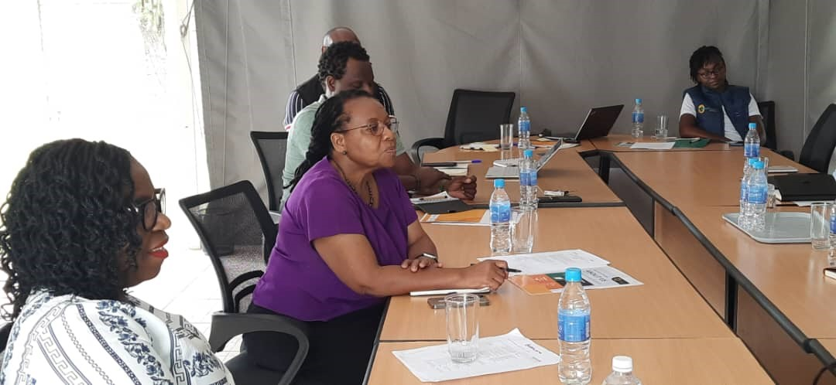
IMPORTANCE OF BOARD OF DIRECTORS
The Board of Directors is there to help each local partner fulfill its mission and to ensure sustainability through:
Providing guidance and oversight of Executive Director and management performance
Ensuring strong governance structures, committees, internal control systems and practices
Ensuring financial stability, credibility, and integrity of financial reporting
Presence of effective decision-making, delegation of authority and accountability
Assisting management in understanding and focusing on continuity, opportunities, and risks the organization faces
Setting up growth strategies and a resource mobilization plan for sustainability

Slide 65
CONSEQUENCES OF POOR BOARD MANAGEMENT
Leadership issues : dysfunctional boards , poor performance, and inattention to results.
Presence of substantial risks to local partner’s long-term performance:
Strategic Risks associated with decisions and operations
Lack of accountability: failure to establish clear lines of board oversight.
Lack of transparency: no trust and confidence between board and management
Legal and regulatory risks: resulting in bad behavior and fraudulent practices
Unclear board reporting processes, leading to governance failure
Conflict of interest: board members with own personal or financial interests resulting in a lack of trust and confidence.
Reputational damage in not meeting stakeholder expectations, loss of donor confidence.
Not delivering on their mandate

Slide 66
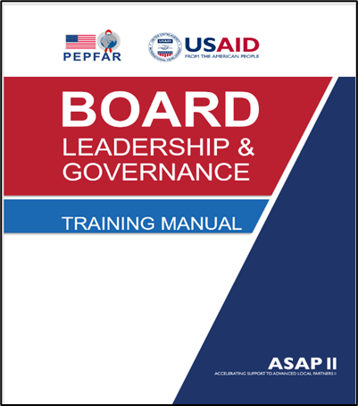
LEADERSHIP & GOVERNANCE TRAINING MANUAL
The objectives of this training manual are to:
Enhance the capacity of the board and management,
Refresh knowledge of board governance,
Highlight the importance of a board mandate and good governance systems,
Share effective leadership and governance principles and tools, and
Improve board capacity for effective board risk oversight, performance management, and strategic leadership.

Slide 67
ENHANCEMENT OF THE BOARD’S ROLE AND RESPONSIBILITIES
Purpose of Governance
Delivered board training to each board and executive leadership on good governance
Provided coaching to each board on its key obligations, roles, and responsibilities
Ensured separation of the Board’s role versus the Executive Director’s role
Optimized use of a Board skills matrix for each board to have the right expertise in the boardroom.
Ensured board independence by encouraging the right systems and structures.
Developed strategies, policies, performance tools, and frameworks for ushering in best practices in the boardroom
Our focus was to work with each board to support and act in the interest of each organization
Notes:
PowerPoint presentations
Self diagnosis approach
Guidelines
Discussions
Critical reflection
Sharing of governance action improvement plan templates

Slide 68
BOARD STRENGTHENING THROUGH PERFORMANCE MANAGEMENT
Purpose of Governance
Our Focus
Enhancement of board members’ knowledge, clarity, and confidence needed for effective decision-making.
Skills development for each board and instilling a practice of regularly refreshing members on effectiveness.
Optimization of each board member’s expertise in the boardroom.
Presence of board efficiency and collaboration in the closure of any capacity gaps and accurate performance measuring.
Celebrating success on the benefits of an engaged and effective board and especially on how it helps each partner accomplish goals.
Notes:
PowerPoint presentations
Self diagnosis approach
Guidelines
Discussions
Critical reflection
Sharing of governance action improvement plan templates

Slide 69
BOARD PERFORMANCE MANAGEMENT
Board’s Culture of Continuous Improvement
Worked with each board on key areas to analyze and measure its effectiveness and performance as follows:
Measurement of achievement of key strategic goals – by taking solid actions to track progress
Operational and financial results: The board understands its current position, being proactive in what needs to change to improve financial performance
Keeping track of key risks and taking steps to prevent and or mitigate them
Reporting systems performance: ensuring the board receives quality reports for insight and to inform its decision-making.
Instilling a culture of continuous improvement, and analyzing and measuring effectiveness and performance
Notes:
PowerPoint presentations
Self diagnosis approach
Guidelines
Discussions
Critical reflection
Sharing of governance action improvement plan templates

Slide 70
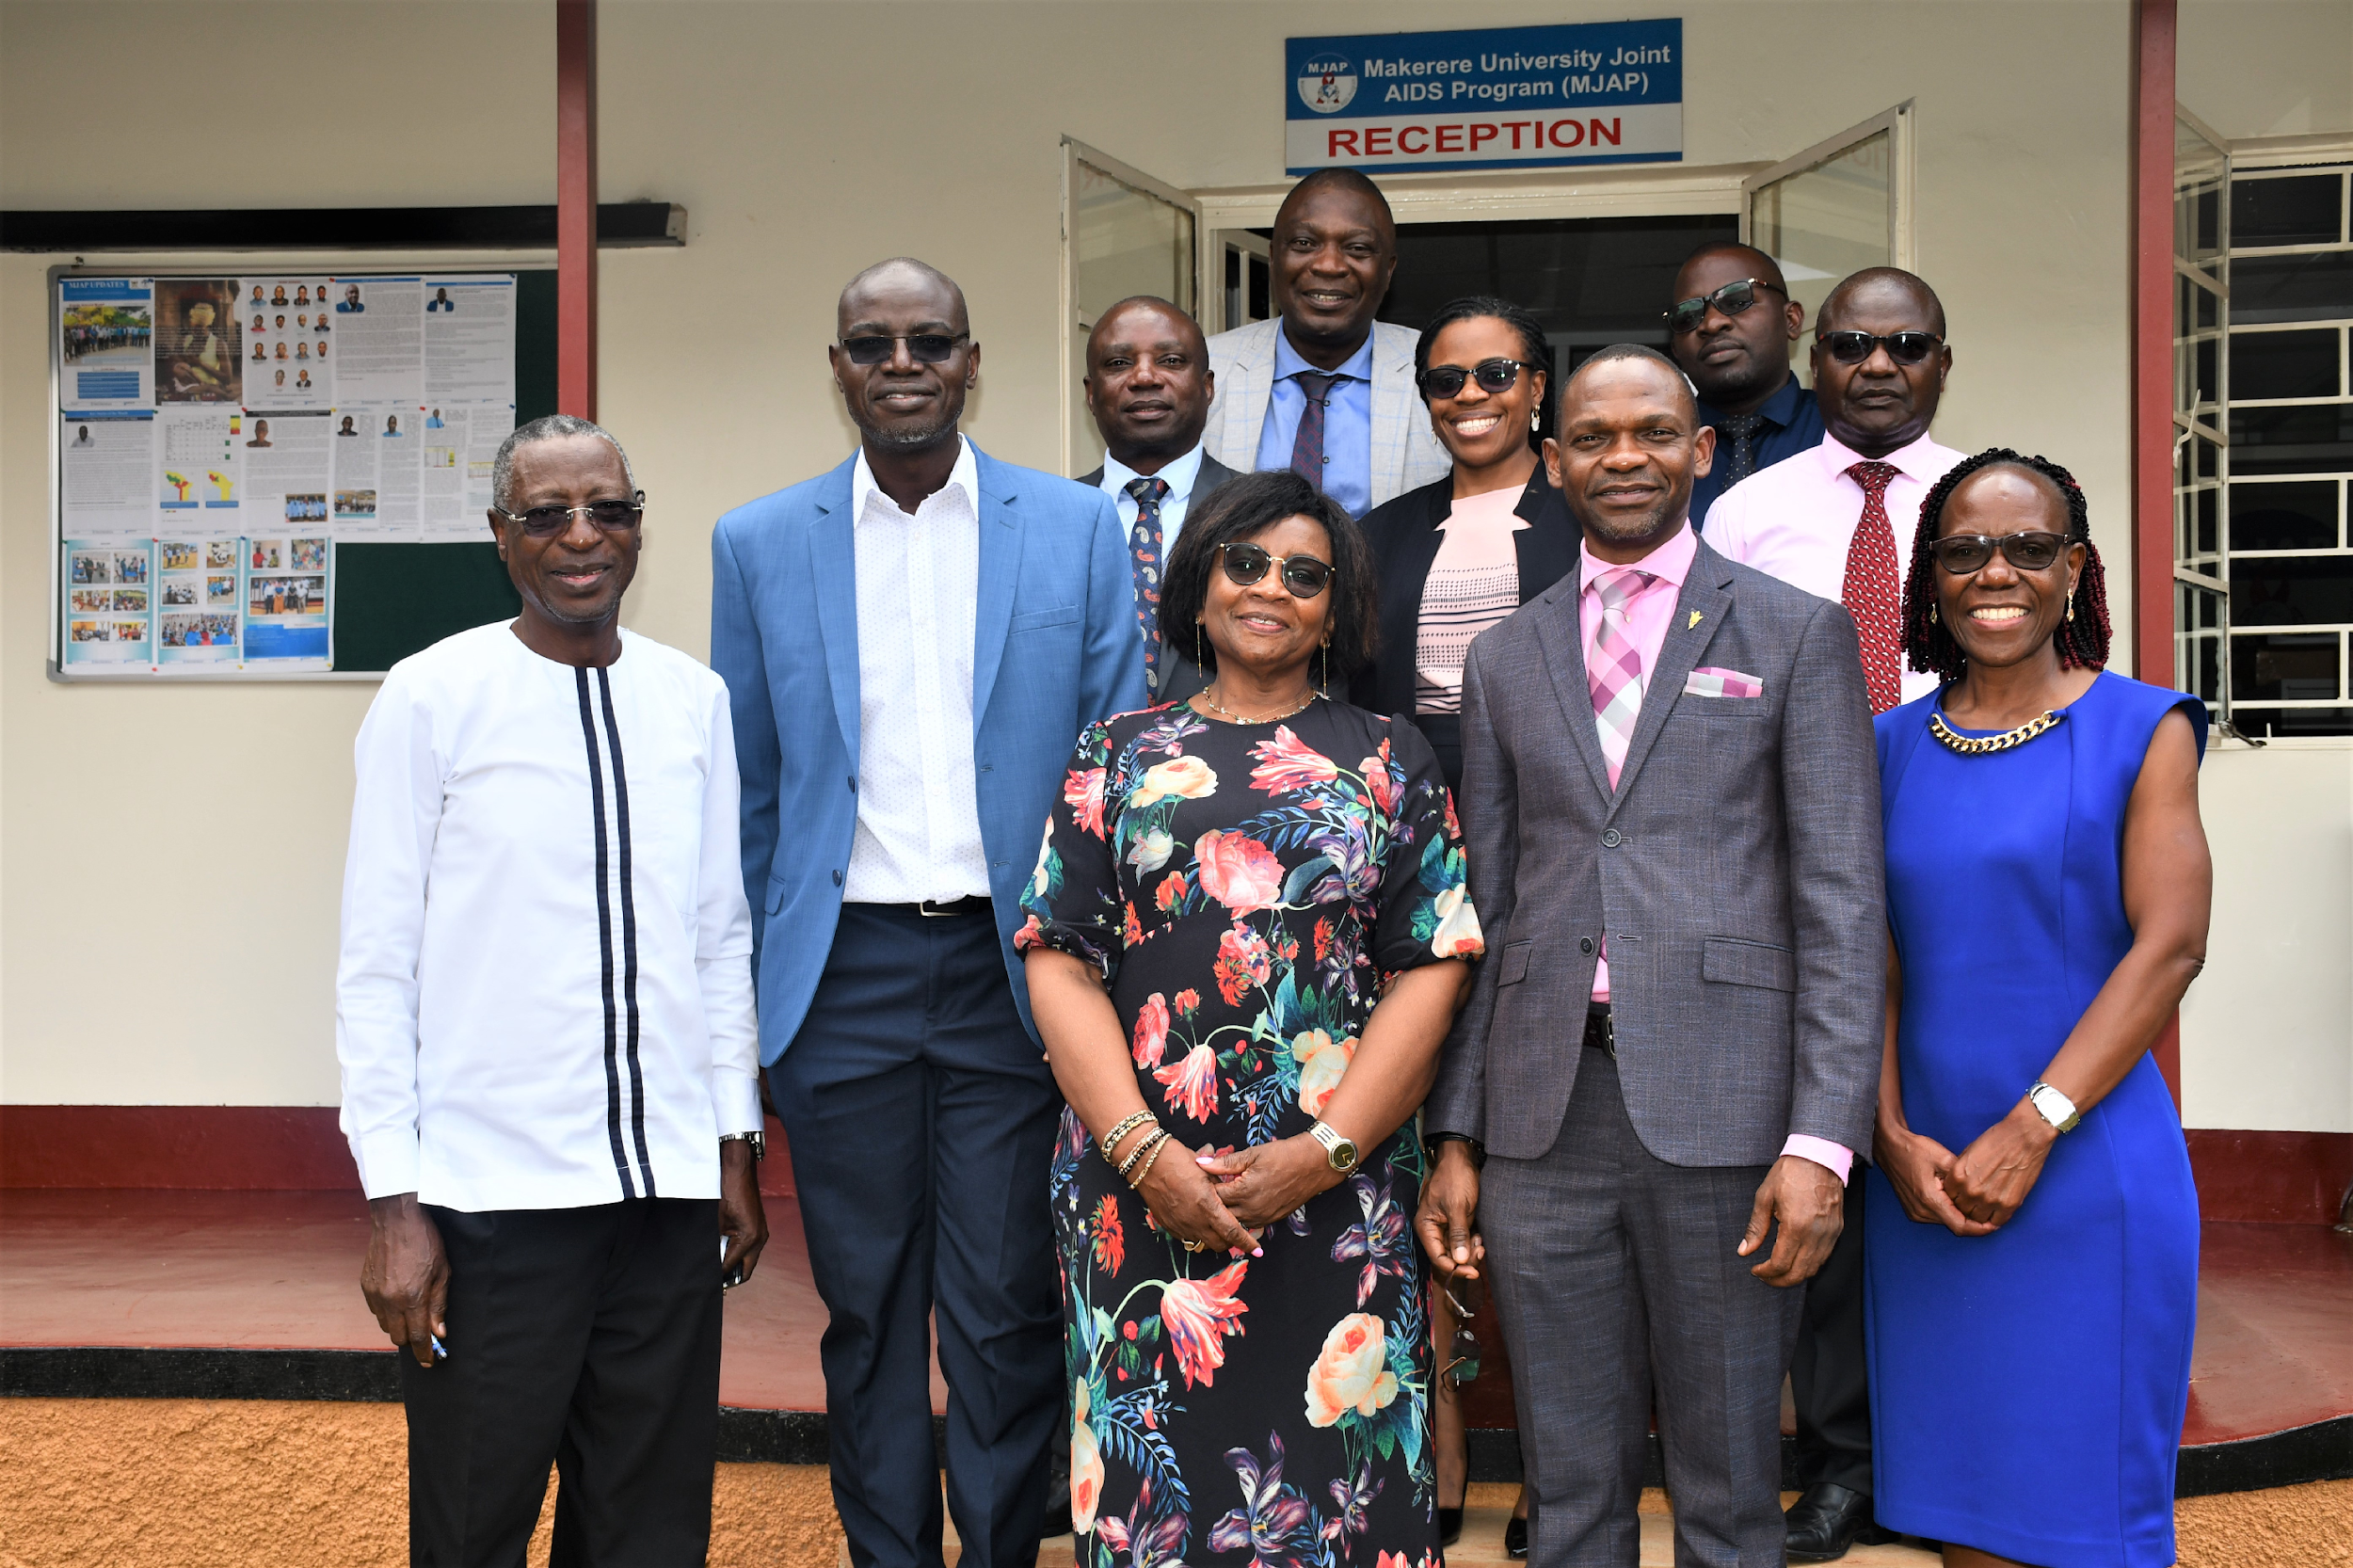
EVALUATION & MEASUREMENT OF BOARD EFFECTIVENESS
Our aim: Board assurance and reassurance that all measures and controls put in place are effective
Board briefings on financials with forecasts - are we on target?
Implementation of strategy/program execution – do we have enough resources to achieve our mission?
Risk management plan – where is our organization vulnerable?
Each LIP addressing issues it is facing
Agreeing options to consider
Actions to take
Key risks to be mitigated, a key manager to oversee the register and mitigation processes
Board and Director self-evaluation assessment: 1:1 and a core group.
Notes:
PowerPoint presentations
Self diagnosis approach
Guidelines
Discussions
Critical reflection
Sharing of governance action improvement plan templates

Slide 71
STRENGTHENING EXECUTIVE LEADERSHIP FOR SUSTAINABILITY
Importance of Having Good Strategic Executive Leaders
Presence of strategic thinkers who are big-picture-focused
Clear about the vision, mission, roadmap, and working in alignment with the Board members
Ensures execution of strategic objectives and outcomes with measurable impact.
Provides direction to staff in a coordinated and sustainable way
Ensuring LIP efficiency and creativity through the deployment of managers with appropriate skills and competencies.
Gaining commitment from all key stakeholders – the board, donors, the service recipients through delivery, stakeholder management, and networking,
Focused very much on Leadership growth
Notes:
PowerPoint presentations
Self diagnosis approach
Guidelines
Discussions
Critical reflection
Sharing of governance action improvement plan templates

Slide 72
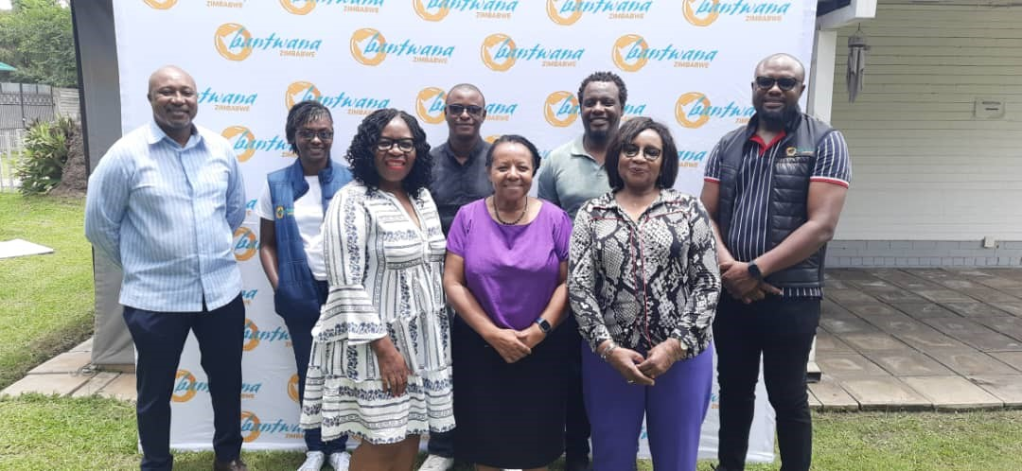
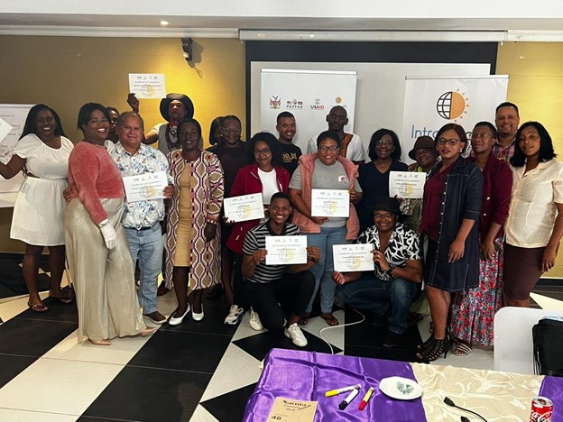
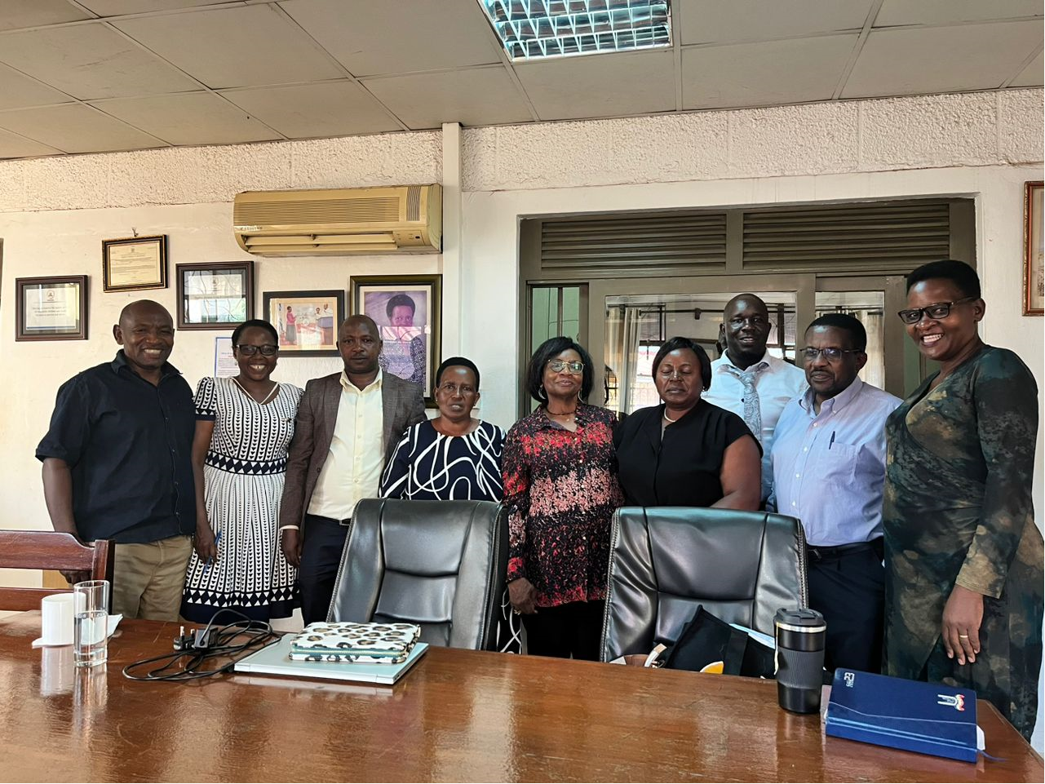
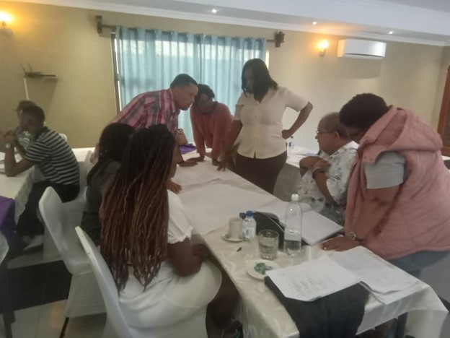
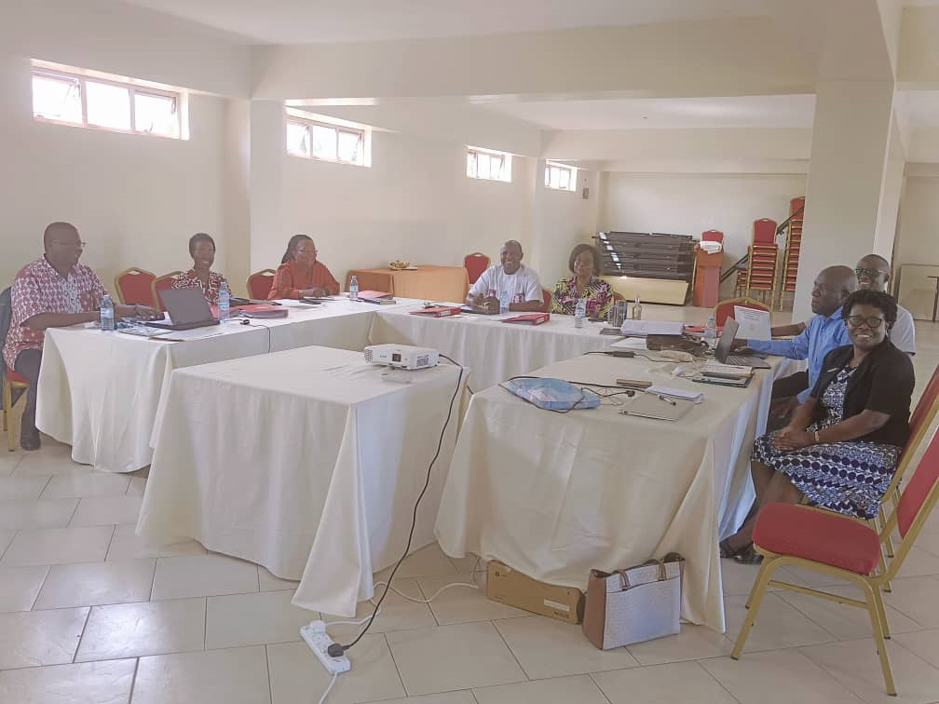
BOARD PHOTOS

Slide 73
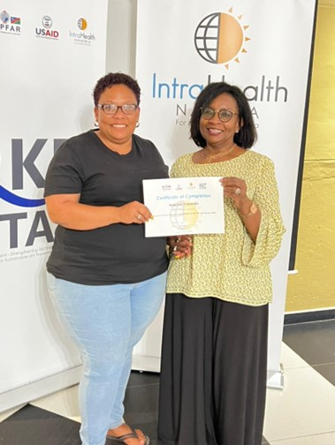
CRITICAL AND UPDATED DOCUMENTS FOR BOARDS
Board Constitution
Board Code of Conduct
Board Maturity Sustainability Model
Board Chair and Board Director Job Descriptions
Board Skills and Competency Matrix
Conflict of Interest Policy
Delegation of Authority
Risk Management Plan
Resource Mobilization Plan
Board Assurance Plan
New Board Member Induction Plan
Board Reserved Matter Agenda

Slide 74
RESOURCE MAPPING AND MOBILIZATION FOR SUSTAINABILITY
Coaching each LIP to be proactive and not reactive in the mobilization of resources for sustainability
Promoting each LIP to have a formal resource mobilization strategy
A designated team whose role is to effectively manage the process
Mapping and Identifying potential sources of funds
Ensuring each LIP board and leadership work in synergy
Explore various resource mobilization strategies including networking with potential donors.
Monitoring progress regularly
For each LIP to be proactive and aim for a diverse portfolio of Donors and take into account the ‘What if scenario’
Notes:
PowerPoint presentations
Self diagnosis approach
Guidelines
Discussions
Critical reflection
Sharing of governance action improvement plan templates

Slide 75
LESSONS LEARNT
Clear understanding of different roles for Executive Director and Board of Directors
Importance of Board independence as it ensures members’ ability to fairly and objectively direct the local partner governance affairs without conflict of interest or undue influence.
Formation of a strong board is critical: having your friend might be a support to you but how much oversight they can contribute is negligible without the right skills you need on your board.
Board assurance is key, through good reporting and getting the right information and perspective with regards to strategy execution and performance.
Training board members is key so that they know the importance of their role in making due diligence, integrity, and being able to stand up for an important point of view.
Importance of Board making important decisions through committees and in the interest of the organization
Board contributing to a good culture of excellence – especially doing the right thing and supporting the Executive Director and management.
Importance of networking and managing stakeholder expectations and not just when you need more resources
Notes:
PowerPoint presentations
Self diagnosis approach
Guidelines
Discussions
Critical reflection
Sharing of governance action improvement plan templates

Slide 76
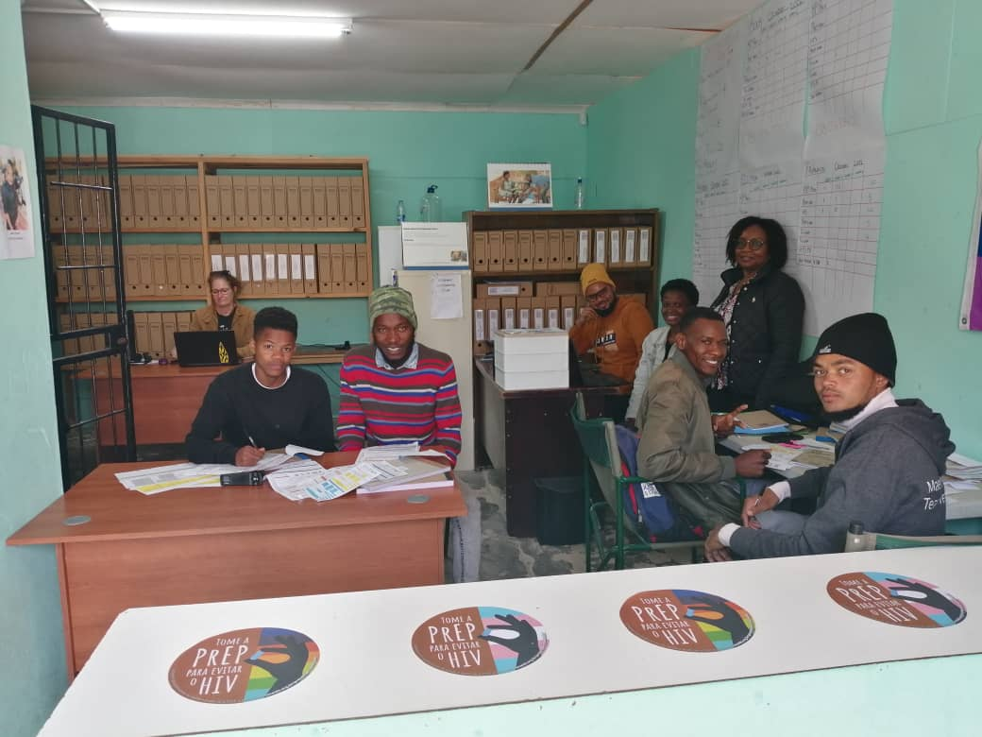
ASAP II CAPACITY ADVISORS: OUR APPROACH AND METHODOLOGY
Our Success is in ASAP II Teamwork and Synergy
Working as one: individually and as part of a team of experts
Demonstrating a shared purpose to supporting all our Local Partners
Focused on effective coordination with clarity on direction and priorities
Paying attention to results for each LIP
Honesty and commitment
Highly engaged throughout the delivery of our work
Notes:
PowerPoint presentations
Self diagnosis approach
Guidelines
Discussions
Critical reflection
Sharing of governance action improvement plan templates

Slide 77
ENSURING BEST PRACTICE AS ASAP II CAPACITY ADVISORS
Setting and agreeing on objectives and principles ASAP II Capacity Strengthening strategy upfront as part of prioritizing exercise for each organization.
Paying attention to the needs of each local partner board, leadership, and holistically
Commitment to enabling and empowering our Local Partner’s Leadership
Acting as a sounding board
Ensuring buy-in and ownership of technical assistance.
Paying attention to avoiding duplication or overwhelming our partners
Notes:
PowerPoint presentations
Self diagnosis approach
Guidelines
Discussions
Critical reflection
Sharing of governance action improvement plan templates

Slide 78
QUESTIONS & ANSWERS

Slide 79
THANK YOU
https://www.intrahealth.org/asap-resources

